Slide 1
Trust of Medical Devices, Applications, and Users in Pervasive Healthcare
Michael Clifford and Matt Bishop
UC Davis Computer Security Laboratory
PETRA 2011

Slide 2
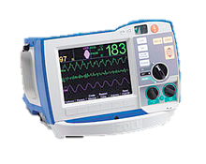
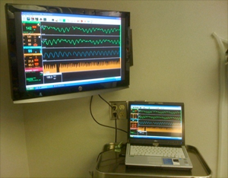
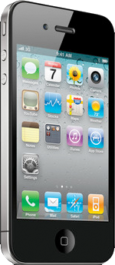
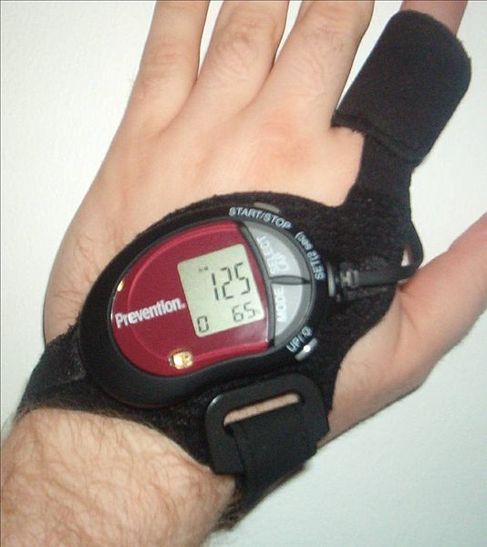
A Patient in a Pervasive Healthcare Environment
Many devices monitor the patient

Slide 3
Sensors, Devices, Doctors, and the Patient Form a Network
Sensors and devices send each other data…

Slide 4
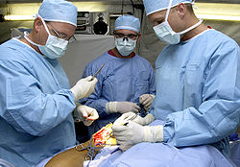
Sensors, Devices, Doctors, and the Patient Form a Network
…and communicate with doctors and nurses

Slide 5
Devices May Be Compromised or an Insider May Manipulate Them
97
Example: a malicious nurse alters the data from a device

Slide 6
Devices May Be Compromised or an Insider May Manipulate Them
44
97
Example: a malicious nurse alters the data from a device

Slide 7
Devices May Be Compromised or an Insider May Manipulate Them
44
The altered data is used by a doctor or device, killing the patient!

Slide 8
Devices May Malfunction For Non-Malicious Reasons
Devices might provide bad data
…or no data!

Slide 9
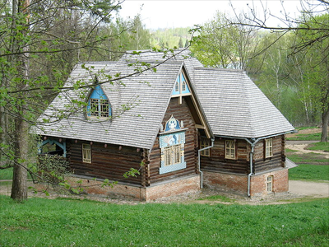
Threat Model
In a pervasive computing environment, there may be much less control over devices than in a hospital

Slide 10
Threat Model
This makes the threat model very different!

Slide 11
Threat Model
The hospital can not control every data source
Patients, caregivers, or even strangers may have access to sensors and devices
Data sources may be networked, and could be attacked from outside!

Slide 12
Healthcare Trust Models
Other trust models grant or deny access to patient data, allow certain people to add to existing records
These extend access control mechanisms in Role Based Access Control

Slide 13
Example of Role Based Access Control
Read Patient Data ✓
Doctors can read and append data, but not alter it

Slide 14
Example of Role Based Access Control
Append Patient Data ✓
Doctors can read and append data, but not alter it

Slide 15
Example of Role Based Access Control
Alter Patient Data ✗
Doctors can read and append data, but not alter it

Slide 16
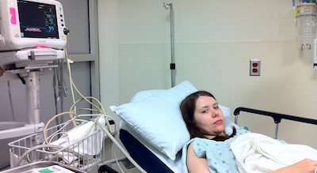
Example of Role Based Access Control
Read Patient Data ✓
Patients can only read data, not append or alter it

Slide 17
Example of Role Based Access Control
Append Patient Data ✗
Patients can only read data, not append or alter it

Slide 18
Example of Role Based Access Control
Alter Patient Data ✗
Patients can only read data, not append or alter it

Slide 19
Healthcare Trust Models
Protect patient privacy and data integrity by restricting access to those who are trusted
Some address context sensitivity
Some address the trustworthiness of users to access data
Don’t examine data source trustworthiness!
These models protect patient privacy, and medical record integrity

Slide 20
Why This is a Problem
They don't provide assurance that the data sources are trustworthy
This leaves data sources such as sensors and devices open to attack and manipulation.
We’d like to provide assurance that patent data sources are trustworthy
Existing healthcare trust models don’t let us do that!

Slide 21
Example – Insider Manipulates Data From a Device
Sensor
Patient
Doctor
Sensor
Medication Dispenser
Sensors monitor the patient

Slide 22
Example – Insider Manipulates Data From a Device
Sensor
Patient
Doctor
Sensor
Medication Dispenser
Sensor data goes to doctor and medication dispenser

Slide 23
Example – Insider Manipulates Data From a Device
Sensor
Patient
Doctor
Sensor
Medication Dispenser
Dispenser medicates patient based on sensor data and doctor’s instructions

Slide 24
Example – Insider Manipulates Data From a Device
Sensor
Patient
Doctor
Sensor
Medication Dispenser
Attacker alters sensor data output

Slide 25
Example – Insider Manipulates Data From a Device
Sensor
Patient
Doctor
Sensor
Medication Dispenser
…producing incorrect data throughout the network

Slide 26
Example – Insider Manipulates Data From a Device
Sensor
Patient
Doctor
Sensor
Medication Dispenser
…Causing the patient to be incorrectly medicated

Slide 27
Example – Insider Manipulates Data From a Device
Sensor
Patient
Doctor
Sensor
Medication Dispenser
…Killing the patient!

Slide 28
Example – Insider Manipulates Data From a Device
Sensor
Patient
Doctor
Sensor
Medication Dispenser
Data privacy and integrity models don’t deal with data sources

Slide 29
Example – Insider Manipulates Data From a Device
Sensor
Patient
Doctor
Sensor
Medication Dispenser
A different trust model is needed

Slide 30
What we need in a trust model
Doctors, patients, and devices should be able to determine how much data from different sources can be trusted relative to each other, or to baselines
Using that information, we can determine whether to utilize information from each source in different contexts

Slide 31
The Solar Trust Model
We can apply the Solar Trust Model to solve this problem

Slide 32
How the Solar Trust Model Handles a Compromised Data Source
Sensor
Patient
Doctor
Sensor
Medication Dispenser
Data source is compromised…

Slide 33
How the Solar Trust Model Handles a Compromised Data Source
Sensor
Patient
Doctor
Sensor
Medication Dispenser
Data consumers have trust policies or heuristics

Slide 34
How the Solar Trust Model Handles a Compromised Data Source
Sensor
Patient
Doctor
Sensor
Medication Dispenser
Policies describe the conditions under which data is trusted

Slide 35
How the Solar Trust Model Handles a Compromised Data Source
Sensor
Patient
Doctor
Sensor
Medication Dispenser
Data from the compromised source violates those policies

Slide 36
How the Solar Trust Model Handles a Compromised Data Source
Sensor
Patient
Doctor
Sensor
Medication Dispenser
Paths including the compromised sensor become less trustworthy…

Slide 37
How the Solar Trust Model Handles a Compromised Data Source
Sensor
Patient
Doctor
Sensor
Medication Dispenser
…and eventually are not trusted!

Slide 38
How the Solar Trust Model Handles a Compromised Data Source
Sensor
Patient
Doctor
Sensor
Sensor
Medication Dispenser
If the network is more complex…

Slide 39
How the Solar Trust Model Handles a Compromised Data Source
Patient
Doctor
Sensor
Sensor
Medication Dispenser
The model can route around the compromised sensor

Slide 40
Conclusion
Pervasive healthcare has a different threat model than traditional healthcare
Traditional models address patient privacy and data integrity, but not trust of data sources
The STM addresses trust of data sources, providing assurance to patients and doctors that data sources are less open to manipulation, malfunction, and attack

Slide 41
Questions?
?

Slide 42
Backup Slides
Backup Slides

Slide 43
WHAT IS THE SOLAR TRUST MODEL?
A global trust network that dynamically models the trust relationships of its users from their perspectives

Slide 44
Solar Systems
A solar system represents a solar trust server (STS) and its relationships with other entities

Slide 45
Solar Systems
Solar Systems contain an ordered, dense set of disjoint orbits, plus a star

Slide 46
Solar Systems
The star represents the STS

Slide 47
Solar Systems
Orbits represent levels of trust
Inner orbits are more trusted than outer orbits

Slide 48
Orbits
An orbit is an unordered set of entities
Orbits are labeled using rational numbers between 0.0 and 1.0

Slide 49
Solar Systems
1.0
0.0
1.0 = Most trusted, 0.0 = least trusted

Slide 50
Minimally Trusted Orbit
Minimally trusted orbit
An orbit may be minimally trusted in a certain context

Slide 51
Minimally Trusted Orbit
✓ Sufficiently trusted
Minimally trusted orbit
Orbits trusted more than the minimally trusted orbit are sufficiently trusted in that context

Slide 52
Minimally Trusted Orbit
✓ Sufficiently trusted
Minimally trusted orbit
✗ Insufficiently trusted
Orbits trusted less than the minimally trusted orbit are insufficiently trusted in that context

Slide 53
Policies
Set of Objects
A policy is a function that maps an entity into a particular orbit in a particular solar system, based on its properties

Slide 54
Relationships
A relationship maps an entity into a specific orbit in a specific solar system based on that solar system’s policies and the current context
f(entity, solar system, policy, context) = orbit

Slide 55
Non-Transitivity of Relationships
Relationships are not transitive
If Alice trusts Bob and Bob trusts Charlie, Alice doesn’t necessarily trust Charlie

Slide 56
Non-Symmetry of Relationships
Relationships are not symmetric
If Alice trusts Bob, Bob does not necessarily trust Alice

Slide 57
Direct Relationships
Based on direct knowledge, experience, and policies about someone or something else
Example:
You know your manager, your parents, and your friends directly
Alice
Bob
Dave
Direct Relationship

Slide 58
Indirect Relationships
Based on what you know about what someone else knows about something
Example:
You have a friend who has a friend who has a doctor. You know that doctor indirectly.
Bob
Alice
Doctor
Charlie

Slide 59
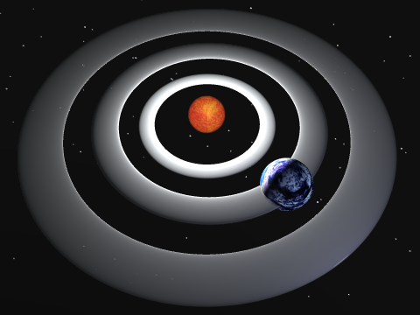
Solar Systems
Planets represent direct relationships with other entities

Slide 60
Solar Systems
Planets are placed into orbits based on trust level

Slide 61
Solar System Recursion
Solar systems are recursively defined

Slide 62
Multiple Solar Systems
A planet is a star in its own solar system

Slide 63
Paths
A path represents one entity’s relationship with another

Slide 64
Paths
A path represents one entity’s relationship with another

Slide 65
Paths
A path represents one entity’s relationship with another

Slide 66
Paths
A path represents one entity’s relationship with another

Slide 67
Multiple Solar Systems And Indirect Relationships
A STS may have an indirect relationship with an entity in another solar system

Slide 68
Maximum Path Length
Each STS specifies a maximum path length
Paths longer than that length are not trusted by the STS

Slide 69
Sufficiently Trusted Relationships
Is this entity trustworthy enough in this context?
Only if it is in an orbit ≥ the minimally trusted orbit

Slide 70
Most Trusted Relationships
Which entity is the most trusted in this context?
The entity in the innermost orbit

Slide 71
Path Discovery
We want to find all sufficiently trusted paths originating at a particular Solar Trust Server
These paths can then be ordered relative to each other by trust, cost, or any other metric
Messages can then be sent to the server using the optimal path for that context

Slide 72
Propagation of a Path Discovery Query Message
Sufficiently Trusted Direct Relationship
Insufficiently Trusted Direct Relationship
Out of Band Reply
A
Solar Trust Server
Path Length = i
Max Path Length = 4

Slide 73
Propagation of a Path Discovery Query Message
A
A
Solar Trust Server A initiates a path query
Path Length = 1
Max Path Length = 4

Slide 74
Propagation of a Path Discovery Query Message
A
AB
C
A trusts B sufficiently
B
A does not trust C sufficiently
Path Length = 2
Max Path Length = 4

Slide 75
Propagation of a Path Discovery Query Message
A
B trusts D and E sufficiently
The paths from A terminate at the entities after D and E
D and E already know these relationships, so they send path replies to A
B
ABD
ABE
D
E
Path Length = 3
Max Path Length = 4

Slide 76
Propagation of a Path Discovery Query Message
ABDF
A
D trusts F sufficiently
Stop
D knows A’s query terminates at F
B
D sends an out of band reply to A
D
D sends ABDF to F
ABDF
F
Path Length = 4
Max Path Length = 4

Slide 77
Propagation of a Path Discovery Query Message
A is removed from the query because its path has terminated
A
B
F propagates BDF unless bound by max path length
D
F
Path Length = 3
BDF...
Max Path Length > 3

Slide 78
Propagation of a Path Discovery Query Message
A
E has no sufficiently trusted direct relationships
B
E
G
H
Path Length = 3
Max Path Length = 4

Slide 79
Propagation of a Path Discovery Query Message
A
ABE
E has no sufficiently trusted direct relationships
B
BE
Stop
E can not propagate any queries
E
E sends out of band replies to A and B
G
H
Path Length = 3
Max Path Length = 4

Slide 80
Propagation of a Path Discovery Query Message
ABDF
A
ABE
AB
C
B
BE
Complete query propagation graph
ABD
ABE
D
E
ABDF
F
G
H
BDF...

Slide 81
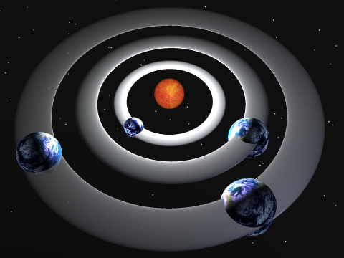
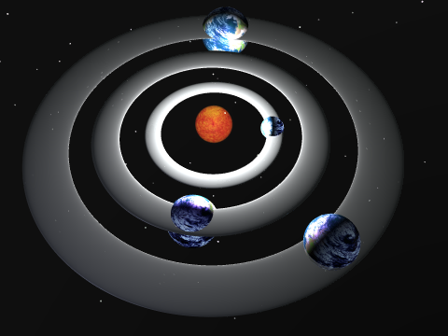
Message Transmission
Receiver
Sender
The message is routed from the sending STS to the receiving STS along the specified path

Slide 82
Rule Sets
Rule Set
3
Rule Set
2
Rule Set
1
Each STS adds its rule set to a message header
Composite rule sets determine trust level

Slide 83
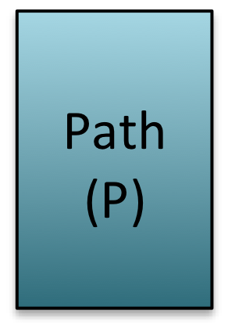
Message Encapsulation
Signed message bodies are re-encapsulated at each hop

Slide 84
Message Encapsulation
Path headers are updated at each hop

Slide 85
Path Updates
A path update algorithm updates paths as relationships change
The trust network always reflects current relationships

Slide 86
Path Aging
Paths become less trusted over time

Slide 87
Authentication
Public keys are as trusted as the paths to those keys

Slide 88
Certificate and Key Distribution and Revocation
Certificates and keys can be distributed along trusted paths
Certificate and key revocation is automatic

Slide 89
Solar Trust Networks
A
C
B
H
D
E
G
F
All nodes + their relationships form a trust network

Slide 90
Solar Trust Networks
A
C
B
H
D
E
G
F
All nodes + their relationships form a trust network

Slide 91
Solar Trust Networks
A
C
B
H
D
E
G
F
All nodes + their relationships form a trust network

Slide 92
Solar Trust Networks
A
C
B
H
D
E
G
F
All nodes + their relationships form a trust network

