Slide 1
Trust of Medical Devices, Applications, and Users in Pervasive Healthcare
Michael Clifford and Matt Bishop, UC Davis Computer Security Laboratory

Slide 2
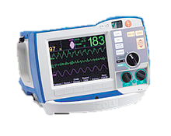
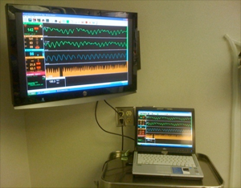
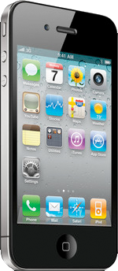
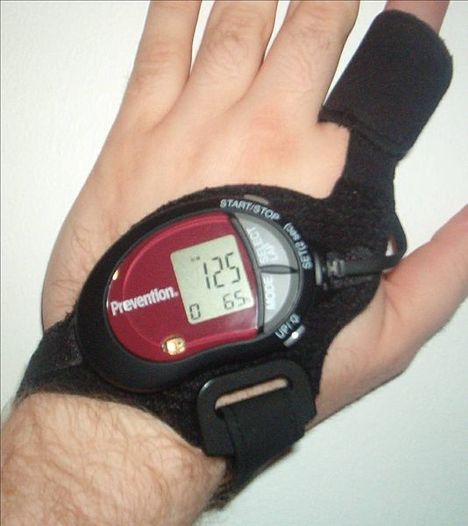
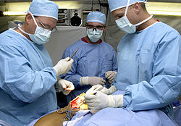
Sensors, Devices, Doctors, and the Patient Form a Network
Sensors, devices, patients, and doctors send each other data

Slide 3
Devices May Be Compromised or Manipulated by Attackers or Malfunctions
44
97
Example: A malicious nurse alters the data from a device. The altered data is used by a doctor or device, killing the patient!

Slide 4
The Threat Model
The hospital can not control every data source
Patients, caregivers, or even strangers may have access to sensors and devices
Data sources may be networked, and could be attacked from outside!
Existing Healthcare Trust Models
Protect patient privacy and data integrity by restricting access to those who are trusted
Some address context sensitivity
Some address the trustworthiness of users to access data
They are designed to protect patient privacy, and medical record integrity
But…they don’t examine data source trustworthiness!

Slide 5
Untrustworthy Data Sources May Provide Bad Data
Existing health care trust models don't provide assurance that data sources are trustworthy
This leaves data sources such as sensors and devices open to attack and manipulation.
We’d like to provide assurance that patent data sources are trustworthy

Slide 6
Example – Insider Manipulates Data From a Device
1
An attacker takes control of a sensor used to monitor the patient.
1
Sensor
Patient
Doctor
2
The attacker causes the sensor to transmit incorrect data to another sensor.
2
4
The bad data, and calculations based on it, propagate through the network, corrupting decisions made by devices and doctors that depend on it.
3
Sensor
Medication Dispenser
3
3
The bad data causes the wrong dosage of medicine to be dispensed, killing the patient.
4
Uncompromised data
Compromised data

Slide 7
What we need in a trust model
Doctors, patients, and devices should be able to determine how much data from different sources can be trusted relative to each other, or to known baselines
Using that information, we can determine whether to utilize information from each source in different contexts

Slide 8
How the Solar Trust Model Handles a Compromised Data Source
1
2
1
An attacker takes control of a sensor used to monitor the patient.
Sensor
Patient
Doctor
2
The attacker causes the sensor to transmit incorrect data to another sensor.
3
4
Medication Dispenser
3
Policies and heuristics cause the path followed by potentially malicious data to become less trustworthy
Sensor
3
3
4
Data sent along paths incorporating the compromised sensor is no longer trusted. The sensor is isolated from the network.
Uncompromised data
Compromised data
5
In some cases, it is possible to route around untrusted sources, selecting only sufficiently trustworthy ones.
Insufficiently trustworthy data
Edge removed from network

Slide 9
Conclusion
Pervasive healthcare has a different threat model than traditional healthcare
Traditional models address patient privacy and data integrity, but not trust of data sources
The Solar Trust Model addresses trust of data sources, providing assurance to patients and doctors that data sources are less open to manipulation, malfunction, and attack

