Slide 1
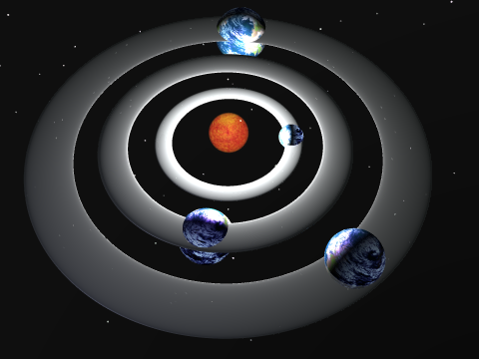
Security, Trusted Backbones, and Social Ontologies in the Solar Trust Model
Qualifying Exam Presentation
Michael Clifford October 6th, 2010
June 6th 2010
© Michael Clifford 2010

Slide 2
How This Talk is Structured
Introduction
Related Work
The Solar Trust Model (My Research)
How the Solar Trust Model Works
Networking and Other Features
Proposed Future Work
Proposed Dissertation Work

Slide 3
Introduction
Introduction
Related Work
The Solar Trust Model (My Research)
How the Solar Trust Model Works
Networking and Other Features
Proposed Future Work
Proposed Dissertation Work

Slide 4
The Problem
Given some entity, such as a person, a message, or a key, can that entity be trusted sufficiently in a particular context?
If multiple entities are being considered, which one can be trusted to the greatest degree?

Slide 5
Example - Finding a Doctor
How do you find a doctor you can trust in a new city?

Slide 6
WHY THE SOLAR TRUST MODEL IS DIFFERENT…
Dense sets of trust levels
Dynamic trust networks and relationship modeling
More accurate(?) modeling of real world decision making processes
Fully non-transitive trust relationships
User specific relative trust with context sensitivity
Local ontologies (proposed)

Slide 7
Related Work
Introduction
Related Work
The Solar Trust Model (My Research)
How the Solar Trust Model Works
Networking and Other Features
Proposed Future Work
Proposed Dissertation Work

Slide 8
The Biba Integrity Model
Object at Higher Integrity Level
✗ Read
Subject
Object at Same Integrity Level
No reads down
✗ Read
Object at Lower Integrity Level

Slide 9
The Biba Integrity Model
Professor
✗ Read
TA
Student Grades
No reads down
✗ Read
Student

Slide 10
The Biba Integrity Model
Object at Higher Integrity Level
✗ Write
Subject
Object at Same Integrity Level
No writes up
✗ Write
Object at Lower Integrity Level

Slide 11
The Biba Integrity Model
Professor
✗ Write
TA
Student Grades
No writes up
✗ Write
Student

Slide 12
The Bell-La Padula Confidentiality Model
Object at Higher Security Level
✗ Read
Subject
Object at Same Security Level
No reads up
✗ Read
Object at Lower Security Level

Slide 13
The Bell-La Padula Confidentiality Model
Professor
✗ Read
TA
Student Grades
No reads up
✗ Read
Student

Slide 14
The Bell-La Padula Confidentiality Model
Object at Higher Security Level
✗ Write
Subject
Object at Same Security Level
No writes down
✗ Write
Object at Lower Security Level

Slide 15
The Bell-La Padula Confidentiality Model
Professor
✗ Write
TA
Student Grades
No writes down
✗ Write
Student

Slide 16
Major Contributions of Biba and BLP
Multiple levels of trust
Relative Trust

Slide 17
Limitations of Biba and Bell-La Padula
All subjects and objects must be part of the same model instantiation, or trust judgments can not be made
A subject, object pair in two model instantiations can violate the confidentiality and integrity rules

Slide 18
Static Trust Classes
18
Professor
TA
Grades
Trusts
Write
Professor
Students
Grades
¬Trusts
Write
Specifies an action, what would prevent an entity from taking that action, and a unique ID

Slide 19
Static Trust Classes
19
Professor
TA
Grades
Trusts
Write
Professor
Students
Grades
¬Trusts
Write
Trust is static with respect to time

Slide 20
Static Trust Paths
Nurses
Trusts
Alice
Doctors
Trusts
Trusts
Patients
Mechanics
¬Trusts
Competitors
Static paths are found from each entity, subject to constraints

Slide 21
MAJOR CONTRIBUTIONS OF STATIC TRUST CLASSES AND PATHS
Trust is evaluated in the context of a specific trust class
Paths of trust - trust depends on constraints imposed by entities along a path

Slide 22
Limitations of Static Trust Classes and Paths
Trust in the real world is not static
People don’t normally classify others in terms of permissions

Slide 23
The PGP Web of Trust Model
4 Fully Trusted Introducer
Keys
8 Marginally Trusted
Introducer
Keys
Or
New Key
New keys are trusted if enough trusted introducer keys trust them

Slide 24
The PGP Web of Trust Model
4 Certificates
2 Certificates
New Key
New Key
Or
(marginally trusted)
(completely trusted)
New Key
New keys are trusted if enough certificates trust them

Slide 25
MAJOR CONTRIBUTIONS OF THE PGP WEB OF TRUST MODEL
Relative trust – Users can trust other users to one of several levels
Non-transitive trust
Popularity based trust (voting)
Public key authentication and identity
Multiple levels of trust, with user defined meaningss

Slide 26
Limitations of the PGP Web of Trust Model
Keys trusted by keys that have been revoked are not themselves revoked
No mechanism for propagating key revocation information
Users can not send messages until they are trusted by enough other users
No context sensitivity – users are either trusted or not, regardless of context

Slide 27
PEM/X.509 Trust Hierarchies
Certificate Authorities issue digital certificates
CA₁
CA₂
CA₃
Certificates make assertions about public keys of lower level entities
User₁
User₂
User₃
Assertions in certificates are signed by the issuer

Slide 28
PEM/X.509 Trust Hierarchies
Entities in a hierarchy with a common root trust each other
CA₁
CA₂
CA₃
User₁ trusts CA₁’s assertions, and CA₁ trusts User₃, so User₁ trusts User₃
User₁
User₂
User₃
But trust in the real world is rarely transitive!

Slide 29
PEM/X.509 Trust Hierarchies
If two users do not have a common root, they can not trust each other
CA₂
CA₃
But users in different organizations may not trust a common root!
User₁
User₂
User₃

Slide 30
PEM/X.509 Trust Hierarchies
Cross certification is used to join disjoint hierarchies
CA₁
But users may not all trust the same internal nodes
CA₂
CA₃
User₁
User₂
User₃
All CAs must cross certify each other to guarantee a trusted hierarchy for each node

Slide 31
PEM/X.509 Trust Hierarchies
CA₁
CA₂
CA₃
Detected bad nodes invalidate all children of the bad node
User₁
User2
User₃

Slide 32
PEM/X.509 Trust Hierarchies
CA₁
Certificates can be revoked, but revocation information may not reach other nodes immediately
✓
CA₂
CA₃
✗
✓
Example: CA₂ revokes User₁’s certificate. User₃ still trusts User₁ until the revocation propagates, causing a race condition
User₁
✗
User₂
User₃
✗
✓

Slide 33
PolicyMaker
Source
Asserts
Where
Authority
Structure
Filter
Sources make assertions in an interpreted language

Slide 34
PolicyMaker
Source
Asserts
Where
Authority
Structure
Filter
Keys request a capability
Action is not
acceptable
PolicyMaker
Engine
Action is
acceptable
Capabilities are granted or denied to keys based on assertions

Slide 35
PolicyMaker
Action is not
acceptable
PolicyMaker
Engine
Action is
acceptable
Decisions are binary

Slide 36
PolicyMaker
Source
Asserts
Where
Authority
Structure
Filter
Keys request a capability
Action is not
acceptable
PolicyMaker
Engine
Action is
acceptable
No mechanism for propagating policies or revocations

Slide 37
PolicyMaker
Source
Asserts
Where
Authority
Structure
Filter
Keys request a capability
Action is not
acceptable
PolicyMaker
Engine
Action is
acceptable
Trust can not always be expressed as an action!

Slide 38
The Distributed Trust Model
Trust categories describe what trust is applied to
Agents must agree on a global ontology for trust categories
Peers request category specific reputation information from each other
Local reputation is computed using a fixed formula by averaging the recommendations of other peers

Slide 39
The Bayesian Network-Based Model
Peer to peer
Peers maintain two Bayesian models for each other peer
Model 1: Models how well a peer provides recommendations
Model 2: Models how well a peer provides a specific service

Slide 40
The Bayesian Network-Based Model
Positive experiences reinforce a model’s score
Negative experiences degrade a model’s score

Slide 41
The Bayesian Network-Based Model
Peers are evaluated on truthfulness and similarity
Truthfulness: How closely Peer A’s experience with Peer C matches Peer B’s recommendation to A about Peer C
Similarity: How closely two peers’ evaluation criteria match

Slide 42
The Bayesian Network-Based Model
Note: Similarity is not the same as correctness!
Peer A could be truthful and similar to Peer B, but both could reach equally bad conclusions!

Slide 43
DSL/KarmaNET
Probabilistic routing of messages based on keywords
Keywords are effectively a “global” ontology
Implemented as an overlay or modified layer 3 network

Slide 44
DSL/KarmaNET
Users accept or reject individual messages
Accept improves the probability of a message routing successfully over a certain path
Reject lowers that probability

Slide 45
The Solar Trust Model (My Research)
Introduction
Related Work
The Solar Trust Model (My Research)
How the Solar Trust Model Works
Networking and Other Features
Proposed Future Work
Proposed Dissertation Work

Slide 46
WHAT IS THE SOLAR TRUST MODEL?
A global trust network that dynamically models the trust relationships of its users from their perspectives

Slide 47
How the Solar Trust Model Works
Introduction
Related Work
The Solar Trust Model (My Research)
How the Solar Trust Model Works
Networking and Other Features
Proposed Future Work
Proposed Dissertation Work

Slide 48
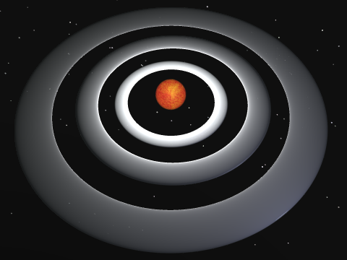
Solar Systems
A solar system represents a solar trust server (STS) and its relationships with other entities

Slide 49
Solar Systems
Solar Systems contain an ordered, dense set of disjoint orbits, plus a star

Slide 50
Solar Systems
The star represents the STS

Slide 51
Solar Systems
Orbits represent levels of trust
Inner orbits are more trusted than outer orbits

Slide 52
Orbits
An orbit is an unordered set of entities
Orbits are labeled using rational numbers between 0.0 and 1.0

Slide 53
Solar Systems
1.0
0.0
1.0 = Most trusted, 0.0 = least trusted

Slide 54
Minimally Trusted Orbit
Minimally trusted orbit
An orbit may be minimally trusted in a certain context

Slide 55
Minimally Trusted Orbit
✓ Sufficiently trusted
Minimally trusted orbit
Orbits trusted more than the minimally trusted orbit are sufficiently trusted in that context

Slide 56
Minimally Trusted Orbit
✓ Sufficiently trusted
Minimally trusted orbit
✗ Insufficiently trusted
Orbits trusted less than the minimally trusted orbit are insufficiently trusted in that context

Slide 57
Policies
Set of Objects
A policy is a function that maps an entity into a particular orbit in a particular solar system, based on its properties

Slide 58
Relationships
A relationship maps an entity into a specific orbit in a specific solar system based on that solar system’s policies and the current context
f(entity, solar system, policy, context) = orbit

Slide 59
Non-Transitivity of Relationships
Relationships are not transitive
If Alice trusts Bob and Bob trusts Charlie, Alice doesn’t necessarily trust Charlie

Slide 60
Non-Symmetry of Relationships
Relationships are not symmetric
If Alice trusts Bob, Bob does not necessarily trust Alice

Slide 61
Direct Relationships
Based on direct knowledge, experience, and policies about someone or something else
Example:
You know your manager, your parents, and your friends directly
Alice
Bob
Dave
Direct Relationship

Slide 62
Indirect Relationships
Based on what you know about what someone else knows about something
Example:
You have a friend who has a friend who has a doctor. You know that doctor indirectly.
Bob
Alice
Doctor
Charlie

Slide 63
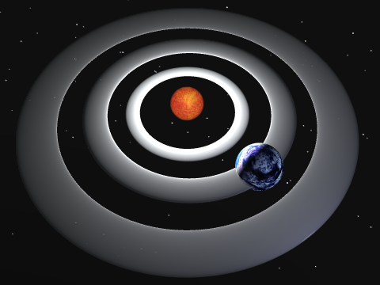
Solar Systems
Planets represent direct relationships with other entities

Slide 64
Solar Systems
Planets are placed into orbits based on trust level

Slide 65
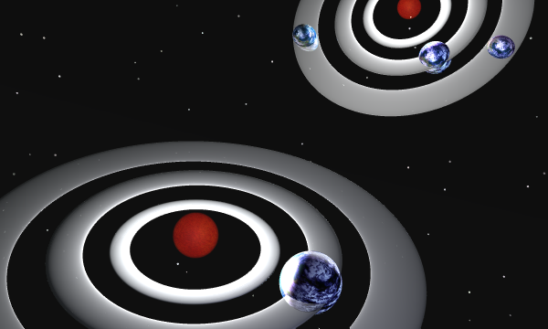
Solar System Recursion
Solar systems are recursively defined

Slide 66
Multiple Solar Systems
A planet is a star in its own solar system

Slide 67
Paths
A path represents one entity’s relationship with another

Slide 68
Paths
A path represents one entity’s relationship with another

Slide 69
Paths
A path represents one entity’s relationship with another

Slide 70
Paths
A path represents one entity’s relationship with another

Slide 71
Multiple Solar Systems And Indirect Relationships
A STS may have an indirect relationship with an entity in another solar system

Slide 72
Maximum Path Length
Each STS specifies a maximum path length
Paths longer than that length are not trusted by the STS

Slide 73
Sufficiently Trusted Relationships
Is this entity trustworthy enough in this context?
Only if it is in an orbit ≥ the minimally trusted orbit

Slide 74
Most Trusted Relationships
Which entity is the most trusted in this context?
The entity in the innermost orbit

Slide 75
Networking and Other Features
Introduction
Related Work
The Solar Trust Model (My Research)
How the Solar Trust Model Works
Networking and Other Features
Proposed Future Work
Proposed Dissertation Work

Slide 76
Path Discovery
We want to find all sufficiently trusted paths originating at a particular Solar Trust Server
These paths can then be ordered relative to each other by trust, cost, or any other metric
Messages can then be sent to the server using the optimal path for that context

Slide 77
Propagation of a Path Discovery Query Message
Sufficiently Trusted Direct Relationship
Insufficiently Trusted Direct Relationship
Out of Band Reply
A
Solar Trust Server
Path Length = i
Max Path Length = 4

Slide 78
Propagation of a Path Discovery Query Message
A
A
Solar Trust Server A initiates a path query
Path Length = 1
Max Path Length = 4

Slide 79
Propagation of a Path Discovery Query Message
A
AB
C
A trusts B sufficiently
B
A does not trust C sufficiently
Path Length = 2
Max Path Length = 4

Slide 80
Propagation of a Path Discovery Query Message
A
B trusts D and E sufficiently
The paths from A terminate at the entities after D and E
D and E already know these relationships, so they send path replies to A
B
ABD
ABE
D
E
Path Length = 3
Max Path Length = 4

Slide 81
Propagation of a Path Discovery Query Message
ABDF
A
D trusts F sufficiently
Stop
D knows A’s query terminates at F
B
D sends an out of band reply to A
D
D sends ABDF to F
ABDF
F
Path Length = 4
Max Path Length = 4

Slide 82
Propagation of a Path Discovery Query Message
A is removed from the query because its path has terminated
A
B
F propagates BDF unless bound by max path length
D
F
Path Length = 3
BDF...
Max Path Length > 3

Slide 83
Propagation of a Path Discovery Query Message
A
E has no sufficiently trusted direct relationships
B
E
G
H
Path Length = 3
Max Path Length = 4

Slide 84
Propagation of a Path Discovery Query Message
A
ABE
E has no sufficiently trusted direct relationships
B
BE
Stop
E can not propagate any queries
E
E sends out of band replies to A and B
G
H
Path Length = 3
Max Path Length = 4

Slide 85
Propagation of a Path Discovery Query Message
ABDF
A
ABE
AB
C
B
BE
Complete query propagation graph
ABD
ABE
D
E
ABDF
F
G
H
BDF...

Slide 86
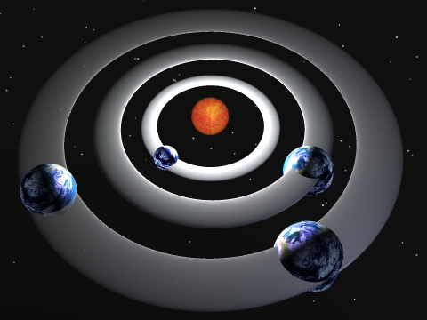
Message Transmission
Receiver
Sender
The message is routed from the sending STS to the receiving STS along the specified path

Slide 87
Rule Sets
Rule Set
3
Rule Set
2
Rule Set
1
Each STS adds its rule set to a message header
Composite rule sets determine trust level

Slide 88
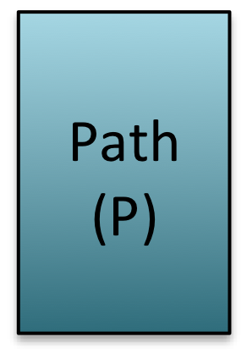
Message Encapsulation
Signed message bodies are re-encapsulated at each hop

Slide 89
Message Encapsulation
Path headers are updated at each hop

Slide 90
Path Updates
A path update algorithm updates paths as relationships change
The trust network always reflects current relationships

Slide 91
Path Aging
Paths become less trusted over time

Slide 92
Authentication
Public keys are as trusted as the paths to those keys

Slide 93
Certificate and Key Distribution and Revocation
Certificates and keys can be distributed along trusted paths
Certificate and key revocation is automatic

Slide 94
Solar Trust Networks
A
C
B
H
D
E
G
F
All nodes + their relationships form a trust network

Slide 95
Solar Trust Networks
A
C
B
H
D
E
G
F
All nodes + their relationships form a trust network

Slide 96
Solar Trust Networks
A
C
B
H
D
E
G
F
All nodes + their relationships form a trust network

Slide 97
Solar Trust Networks
A
C
B
H
D
E
G
F
All nodes + their relationships form a trust network

Slide 98
Proposed Future Work
Introduction
Related Work
The Solar Trust Model (My Research)
How the Solar Trust Model Works
Networking and Other Features
Proposed Future Work
Proposed Dissertation Work

Slide 99
Policies, Local Ontologies, and the Meaning of Relationships

Slide 100
Policies, Local Ontologies, and the Meaning of Relationships
The meaning of information depends on its social context
But we need to find entities that are referring to the same thing!

Slide 101
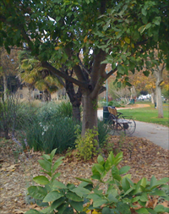
Policies, Local Ontologies, and the Meaning of Relationships
Example: what is a tree?
A
B
C
D
E
F
?
?

Slide 102
Policies, Local Ontologies, and the Meaning of Relationships
A
B
C
D
E
F
Bob
Charlie
Alice
Example: Alice has questions about trees
Bob and Charlie are both experts on trees. Who should she ask?

Slide 103
Policies, Local Ontologies, and the Meaning of Relationships
A
B
C
D
E
F
Bob
Charlie
Alice
Alice forms a relationship with Bob in this context because he gives her good information about the right kind of tree

Slide 104
Policies, Local Ontologies, and the Meaning of Relationships
A
Trees
Plants
B
C
Soil
Water
Data Structures
Rainfall Frequency
Soil Data
D
E
F
Hypothesis: people will form relationships based in part on who gives them information that is relevant to them in a certain context

Slide 105
Policies, Local Ontologies, and the Meaning of Relationships
A
Trees
Plants
B
C
Soil
Water
Data Structures
Rainfall Frequency
Soil Data
D
E
F
Relationships may incorporate locally meaningful ontologies without the need for global ontologies

Slide 106
Policies, Local Ontologies, and the Meaning of Relationships
A
Trees
B
Data Structures
D
Paths could then be found that incorporate context and locally relevant meaning without a global definition for each term or context

Slide 107
Significance of Local Ontologies
Information is more trustworthy if it is likely to be correct and relevant
The STM’s social network structure may automatically form around correct and relevant information
This might be generalized to aid in search on other kinds of social networks in the future

Slide 108
Ontology Study Methodology
Two human studies, compared against simulation data
Human study of direct relationship formation
Human study of indirect relationship formation
Compare results against simulation data

Slide 109
Ontology Study Success
Compare the probability with which the expected relationships form in the human tests against the probability of those relationships forming by chance
If the hypothesis is validated, the result can be applied to other problems
If the hypothesis is invalidated, we learn a significant limitation in how networks of relationships form

Slide 110
Solar Trust Model Security

Slide 111
Solar Trust Model Security
Are there security holes in the Solar Trust Model?

Slide 112
Solar Trust Model Security
Evaluation of the Solar Trust Model against known attacks on other trust models, recommendation systems, and networks
Development of countermeasures against the attacks, or proof of non-vulnerability
Potentially, develop new types of attacks, and generalize them for use against other trust models
Success: Demonstration of non-vulnerability to known or new attacks, and modification to resist those attacks.

Slide 113
Solar Trust Model Security - Significance
Reduces the likelihood that the STM can be manipulated or attacked, producing untrustworthy results
Attacks and defenses may apply to other networks and trust models as well

Slide 114
Solar Trust Network Organization

Slide 115
Organization of a Trust Network
How do Solar Trust Networks organize themselves?

Slide 116
Organization of a Trust Network
A
G
H
C
B
D
E
F
Do trusted backbones form?

Slide 117
Organization of a Trust Network
G
A
H
C
B
F
E
Do certain nodes become widely trusted (and therefore more important)?

Slide 118
Significance of Trust Network Organization 1/2
Security - Attacking a few highly trusted nodes might disrupt the wider network
Enhanced trust - A few nodes with high connectivity could reduce the hops between any two random nodes, thus increasing trust
Greater indirect connectivity - If many paths run through a small set of nodes, the probability of a path between two random nodes increases

Slide 119
Significance of Trust Network Organization 2/2
Performance - Highly connected nodes could produce bottlenecks,
Economics - Nodes that are widely trusted might charge a fee
Network stability - If a highly connected node changes a relationship, a very large number of paths may change simultaneously

Slide 120
Trust Network Organization Methodology
Simulate a solar trust network
Compare number of direct and indirect relationships with message flow at each node
Compare with results from a real world user study

Slide 121
Trust Network Organization Success
The study is successful whether or not trusted backbones or highly trusted nodes are present
If present, future work can take advantage of that organization
If not present, future work can address the randomness of relationships

Slide 122
New Routing Algorithms

Slide 123
New Routing Algorithms
The STM currently uses source routing
Source routing guarantees routing along trusted paths, but doesn’t adapt to path changes mid-flight
Signing at every hop is inefficient, but maintains freshness of policy info

Slide 124
New Routing Algorithms
Alternative 1: “Standard” In flight routing
Similar to IP routing - the next hop is found at each node
May generate fresher results, at the cost of a new path lookup at each hop
Routes around nodes that become invalid in flight

Slide 125
New Routing Algorithms
Alternative 2: Virtual Trusted Path Routing
Messages are signed by the sender and sent directly to the receiver
Receiver assumes the message was routed along the most trusted path to the signing key
Greatly reduced overhead, but potentially reduced path freshness

Slide 126
New Routing Algorithms
Which algorithm is the best?
Method: Collect and analyze routing data for each algorithm for different network configurations
Evaluate results for performance, improve algorithms based on results

Slide 127
New Routing Algorithms - Significance
A better routing algorithm could greatly enhance STM performance and scalability
Understanding the tradeoffs could allow users to chose which routing method best suits their needs

Slide 128
The Solar Trust Model as a Superset of Other Trust Models

Slide 129
The Solar Trust Model as a Superset of Other Trust Models
Which other trust models can the Solar Trust Model emulate?
Is it a superset of existing trust models?

Slide 130
The Solar Trust Model as a Superset of Other Trust Models
Methodology:
Prove that each other trust model can be emulated using the Solar Trust Model

Slide 131
The Solar Trust Model as a Superset of Other Trust Models
Success:
Proofs of which other trust models the STM can and can not emulate

Slide 132
The Solar Trust Model as a Superset of Other Trust Models
Significance:
The STM can interoperate with existing trust models if it can emulate them
The STM is a more general trust model than models that it can emulate
Finding models that it can not emulate (if any) establishes limits on the STM’s capabilities

Slide 133
Policies

Slide 134
Policies for Mapping Entities Into Orbits
Algorithms for mapping entities into orbits are needed in the model
Significance: Required for full model implementation
Success: Creation of a policy language or algorithms to map entities into orbits

Slide 135
Networking and Other Features
Introduction
Related Work
The Solar Trust Model (My Research)
How the Solar Trust Model Works
Networking and Other Features
Proposed Future Work
Proposed Dissertation Work

Slide 136
Proposed Dissertation Work
1) Ontology study
2) Solar trust network organization study
The other studies can be used as backups in case the first two bottleneck or do not go as planned

Slide 137
Why Those Two?
These two studies are riskier, but have the most significant results
I’ll learn the most by doing them
About the right amount of work for a dissertation

Slide 138
Solar Trust Model Publications
Michael Clifford, Charles Lavine, and Matt Bishop, “The Solar Trust Model: Authentication Without Limitation”, in the Proceedings of the 14th Annual Computer Security Applications Conference, pp. 300-307, 1998
Michael Clifford, “Networking in the Solar Trust Model: Determining Optimal Trust Paths in a Decentralized Trust Network”, in the Proceedings of the 18th Annual Computer Security Applications Conference, pp. 271-281, 2002
Michael Clifford “An Implementation And Performance Analysis Of The Solar Trust Model, A Dynamic, Distributed Trust And Authentication Model”, Masters thesis, The George Washington University, May 2nd, 2006.

Slide 139
Questions?

Slide 141
Detailed Timelines

Slide 142
Ontology Study Time Requirements
Optimistic
Realistic
Design of studies
1 Week
2 Weeks
Get IRB approval
6 Weeks
12 Weeks
Obtain study participants
2 Weeks
4 Weeks
Run human trials
2 Weeks
2 Weeks
Simulation development and testing
4 Weeks
8 Weeks
Analysis
2 Weeks
4 Weeks
Background Research
2 Weeks
4 Weeks
Write Ontology Chapter
2 Weeks
3 Weeks
Ontology Paper
2 Weeks
4 Weeks
Totals
25 Weeks
47 Weeks

Slide 143
Solar Trust Model Security
Optimistic
Realistic
Background research on existing attacks
3 Weeks
4 Weeks
Survey paper on existing attacks
1 Week
2 Weeks
Application of existing attacks to the STM
1 Week
2 Weeks
Mitigation of existing attacks against the STM
1 Week
2 Weeks
Proofs that the model is not vulnerable to known attacks
2 Weeks
3 Weeks
Attempt to find new classes of attacks
1 Week
2 Weeks
Mitigation of new attacks
2 Weeks
2 Weeks
Application of attacks to other trust models
2 Weeks
3 Weeks
Dissertation Chapter
2 Weeks
2 Weeks
Security publication
3 Weeks
4 Weeks
Totals
18 Weeks
26 Weeks

Slide 144
Trust Network Organization
Optimistic
Realistic
Simulation Development
6 Weeks
10 Weeks
Simulation
1 Week
2 Weeks
Analysis
1 Week
3 Weeks
IRB approval
8 Weeks
12 Weeks
Human study design
1 Week
2 Weeks
Human study
1 Week
1 Weeks
Analysis of human study
1 Weeks
2 Weeks
Dissertation Chapter
2 Weeks
3 Weeks
Publication
2 Weeks
3 Weeks
Totals
23 Weeks
38 Weeks

Slide 145
Routing Algorithms
Optimistic
Realistic
Additional Simulation Development
4 Weeks
6 Weeks
Simulation
2 Weeks
3 Weeks
Analysis
2 Weeks
3 Weeks
Dissertation Chapter
2 Weeks
3 Weeks
Publication
3 Weeks
4 Weeks
Totals
13 Weeks
19 Weeks

Slide 146
Policies
Optimistic
Realistic
Development of Policy Algorithms or Language
4 Weeks
6 Weeks
Simulation
6 Weeks
8 Weeks
Analysis
2 Weeks
3 Weeks
Dissertation Chapter
2 Weeks
3 Weeks
Publication
3 Weeks
4 Weeks
Totals
17 Weeks
24 Weeks

Slide 147
Formal Definitions

Slide 148
RELATIVE TRUST (FORMAL)
Given two objects, O_{A} and O_{B}:
If Trust(E, O_{A},C) > Trust(E, O_{B},C), then O_{A} is relatively more trusted than OB by entity E in context C
If Trust(E, O_{A},C) < Trust(E, O_{B},C), then O_{A} is relatively less trusted than O_{B} by entity E in context C
If Trust(E, O_{A},C)= Trust(E, O_{B},C), then O_{A} has been assigned equal relative trust to O_{B} by entity E in context C.

Slide 149
The Biba Model (Formal)
Given:
s a subject
S a set of subjects
o an object
O a set of objects
il an integrity level
o a read (observe) operation
m a modify operation
i an execute (invoke) operation
∀s∈S, o∈O, s o o → il(s) ≤ il(o)
(No reads down)
∀s∈S, o∈O, s m o → il(o) ≤ il(s)
(No writes up)
∀s₁,s₂ ∈S, s₁ i s₂ → il(s₂) ≤ il(s₁)
(No executes up)

Slide 150
The Bell-LaPadula Model (Formal)
Given:
s a subject
S a set of subjects
o an object
O a set of objects
sl a security level
o a read (observe) operation
m a modify operation
∀s∈S, o∈O, s o o → sl(o) ≤ sl(s)
(No reads up)
∀s∈S, o∈O, s m o → sl(s) ≤ sl(o)
(No writes down)

Slide 151
The PGP Web of Trust Model
PGP has two types of trust
Certificate trust
A user’s public key is the subject of a certificate
Certificates make assertions about otherwise unknown keys
Three levels of certificate trust
Introducer trust
One user’s public key is trusted to a certain degree by a second user to “introduce” the second user to a third user’s public key by claiming that the third user’s key is valid
Four levels of introducer trust
Only sufficiently trusted keys may make introductions

Slide 152
The PGP Web of Trust Model
User Defined Trust
Each user decides:
How many certificates must assert trust in a new key for that key to be trusted
How trusted those certificates must be
How many introducer keys must assert trust in a new key for that key to be trusted
How trusted those keys must be
Users also decide the meaning of each trust level

Slide 153
Orbits
Given:
Let E = {E₁, ..., E_{n}} be a set of entities.
Let U = {U₁, ..., U_{n}} be a set of users.
Let C = {C₁, ..., C_{n}} be a set of contexts.
Let O = {O₁, ..., O_{n}} be a set of orbits.
Then:
All entities in the same orbit are trusted equally:
∀ E_{i}, E_{j} ∈ O_{i}, E_{i} ≠ E_{j}, Trust(U_{i},C_{i},E_{i}) = Trust(U_{j},C_{j},E_{j})
Two entities in different orbits are trusted to different extents
∀ E_{i} ∈ O_{i}, E_{x} ∈ O_{x}, E_{i} ≠ E_{x}, Trust(U_{i},C_{i},E_{i}) ≠ Trust(U_{i},C_{i},E_{x})
No two orbits have the same level of trust
Trust(O_{i}) ≠ Trust(O_{j})
The higher the label of an orbit, the more trusted it is:
Trust(U_{i},C_{i},O_{i}) < Trust(U_{i},C_{i},O_{j}), i < j

Slide 154
Dense Trust Levels
To represent the relative degree of trust that any entity may place in another, dense trust levels must be used.
Objects trusted to the same degree occupy the same trust level:
Let L = {L₁...Ln} be a set of trust levels and O = {O1...On} be a set of objects.
Then ∀O ∈ O: If Trust(Oi) = Trust(Oj), then Oi ∈ L_{m} and Oj ∈ L_{m}
An object in a higher labeled trust level is trusted more than an object in a lower labeled one:
If Trust(O_{i}) > Trust(O_{j}), then:
if O_{i} ∈ L_{m} and O_{j} ∈ L_{x}, L_{m} ≠ L_{x}, Trust(L_{m}) > Trust(L_{x})

Slide 155
Dense Trust Levels
It must always be possible to insert a new trust level above or below any given trust level:
Assign exactly one object to each existing trust level:
Let L = {L₁...L_{n}} be a set of discrete trust levels with L_{i} ≠ L_{j}
Let O = {O₁...O_{n}} be a set of objects, where O_{i} ∈ L_{i}
Then |L_{i}| = 1, ∀ L_{i} ∈ L
Now, we want to add a new object O_{x} that is trusted to a different extent than any existing object:
If Trust(O_{x}) ≠ Trust(O_{m}) ∀ L_{m} ∈ L, then O_{x} ∉ L_{m}.
Clearly, O_{X} can’t be assigned to any existing trust level!

Slide 156
Dense Trust Levels
But…we must be able to assign a trust level to the new object. So we must create a new trust level with the appropriate degree of relative trust. Therefore:
Given O_{x} ∈ L_{x}, L_{x} ∉ L, then:
If Trust(O_{x}) > Trust(O_{i}), ∀ O_{i} ∈ O, then Trust(L_{x}) > Trust(L_{i})
If Trust(O_{x}) < Trust(O_{i}), ∀ O_{i} ∈ O, then Trust(L_{x}) < Trust(L_{i})
If Trust(O_{i}) < Trust(O_{x}) < Trust(O_{j}), O_{i} ∈ O, O_{j} ∈ O, then
Trust(L_{i}) < Trust(L_{x}) < Trust(L_{j})
Therefore,
∃ L’ such that L’ = L ∪ L_{x}, O_{x} ∈ L_{x}, L_{x} ∉ L
Since we must be able to insert new trust levels, the trust levels must form a dense set

Slide 157
Solar Systems (Formal)
A Solar System is formally defined as:
Let Solar System_{i} be some Solar System.
Let O = {O_{0.0}, ..., O_{1.0}} be a set of orbits, O_{n} ∈ Solar System_{i}
Let S_{i} be the star in Solar System_{i}
Then:
S_{i} ∈ O_{1.0}
O_{i} < O_{j}, 0 ≤ i < j ≤ 1
Trust(O_{i}) < Trust(O_{j})
Solar System = ∪ O_{n}, ∀ O_{n} ∈ O
Orbits are labeled with rational numbers, which guarantees that a solar system contains a dense set of orbits

Slide 158
Minimally Trusted Orbit (Formal)
The minimally trusted orbit is formally defined as:
Let:
E₁ and E₂ be entities,
C be a context,
S be a Solar system of E₁,
O={O₀, ..., O_{M},... O₁} be the set of orbits in S
Then:
O_{M} is the minimally trusted orbit of S for context C if:
∀ O_{i} < O_{M}, Trust(E₁,O_{i},C} is not sufficient,
and:
∀ O_{i} ≥ O_{M}, Trust(E₁,O_{i},C} is sufficient.

Slide 159
Policies (Formal)
The formal definition of a policy is:
Let Solar System_{i} be some Solar System
Let O = {O_{0.0}, ..., O_{1.0}} be a set of orbits, O_{n} ∈ Solar System_{i}
Let E = {E₁, ..., E_{n}} be a set of entities
Let C = {C₁, ..., C_{n}} be a set of contexts
Let P = {P₁, ..., P_{n}} be a set of properties of entities.
Then a policy can be represented with the function:
f(O_{i},E_{j},C_{k},P_{l}) = orbit

Slide 160
Direct Relationships (Formal)
Let E₁ and E₂ be two entities
Let S_{i} be the solar system of E₁
Then if E₁ has a direct relationship with E₂:
∃ an orbit O_{i} such that E₂ ∈ O_{i} and O_{i} ∈ S₁
We designate
D_{RS} = <E_{R}, O_{R}, E_{S}, C_{i}>
as a direct relationship from orbit R in the solar system of E_{R} to E_{S} in the context C_{i}.

Slide 161
Paths (Formal)
A path is an ordered set of pairs <S, O> such that the following conditions are met:
1) S is an STS.
2) For each S, O is the orbit in the solar system of S that contains the entity from which that S directly received the message.
3) The set contains all of the STSs traversed by the message.
4) The set is ordered by the sequence in which the message traversed those STSs, beginning with the STS that ultimately received the message, and terminating with the STS that originally sent the message.
5) If an STS appears on the path more than once, the path terminates at the second instance of that STS.
Note: This definition is from [CLI02], [CLI06]

Slide 162
Indirect Relationships (Formal)
Given:
E = {E₁, E_{R}, ..., E_{S},..., E_{n}} is a set of entities
Let P_{RS} be a path from E_{R} to E_{S}
Let C_{r} be a context in which each E_{r} evaluates the trust relationships in its solar system
Let D_{RS} = <E_{R}, O_{R}, E_{S}, C_{i}> be a direct relationship between some E_{R} and E_{S} ∈ E
Then:
E_{i} has an indirect relationship with E_{j} if ∀ (E_{i}, E_{j}) ∈ P_{RS}, E_{i} has a direct relationship with E_{j} in context C_{i}
In other words:
D_{ij} = <E_{i}, O_{i}, E_{j}, C_{i}> ∀ E_{i},E_{j} ∈ P_{RS}

Slide 163
Subpaths
A subpath is any contiguous subset of a path
Formally:
A subpath of a path is any subset of a path that meets the following properties:
Let P_{i} = a pair <S_{i},O_{i}>
Let the path P = (P₁, ..., P_{n})
Let 1 ≤ i ≤ j ≤ n
Then a subpath SP is any path SP = (P_{i},...,P_{j}), where SP ⊆ P.

Slide 164
Sufficiently Trusted Direct Relationships
A sufficiently trusted direct relationship is defined as:
Let E₁ and E₂ be entities,
Let C be a context
Let S be a Solar system of E₁,
Let O={O₀, ...,O_{M},... O₁} be the set of orbits in S, and M be the minimally trusted orbit in S for context C.
Then E₁ has a sufficiently trusted direct relationship with E₂ iff E₂ ∈ {O_{M},... O₁}
Any direct relationship that does not meet those criteria is an insufficiently trusted direct relationship

Slide 165
Sufficiently Trusted Indirect Relationships
A sufficiently trusted indirect relationship is defined as:
Given:
E = {E₁, E_{R}, ..., E_{S},..., E_{n}} is a set of entities.
Let P_{RS} be a path from E_{R} to E_{S}.
Let C_{r} be a context in which each E_{r} evaluates the trust relationships in its solar system.
Let D_{RS} = <E_{R}, O_{R}, E_{S}, C_{i}> be a direct relationship between some E_{R} and E_{S} ∈ _{E}.
Let {O_{M},... O₁}_{i} be the set of sufficiently trusted orbits in solar system S_{i}.
Then E_{R} has a sufficiently trusted indirect relationship with E_{S} if:
D_{ij} = <E_{i}, O_{i}, E_{j}, C_{i}> and O_{i} ∈ {O_{M},... O₁}_{i} ∀ E_{i},E_{j} ∈ P_{RS}
In other words, a sufficiently trusted indirect relationship exists iff each entity in P_{RS} has a sufficiently trusted direct relationship with the next entity along the path

Slide 166
Definitions…

Slide 167
Trust Model
A framework for providing a degree of confidence to a user
Allows the user to determine whether or not to accept or “trust” some message or other user

Slide 168
Context
Context is the information used to make a trust judgment, and a set of constraints on the scope of that judgment
Example: Alice knows that surgeons have studied medicine, but does not know if they have studied car repair

Slide 169
Entities
An entity is any object, such as a person, system, key, message, or any other information

Slide 170
Trust
Trust is a subjective and relative degree of confidence that one entity has in another to meet certain criteria
Example: Alice trusts surgeons to perform surgery, but not to repair her car, based on her knowledge of surgeons and auto repair

Slide 171
Subjective Trust
Given:
Entity E
Object O
Context C
Degree of trust, D
The subjective trust function:
Trust(E,O,C) = D
Means E trusts O to degree D in context C

Slide 172
Relative Trust
Relative trust represents the trust that an entity E places in the elements of a set of objects as a partial ordering, rather than a value
It makes sense to say “Alice trusts Bob to repair her car more than Charlie”, but not “Alice trusts Bob .75x as much as Charlie”

Slide 173
Contextual Trust
The extent to which one entity trusts another depends on the context in which the trust judgment is being made
Example: a doctor is trusted in the context of medical recommendations, but not necessarily in the context of flying an airplane
Given an entity E and a set of contexts C:
∃ C_{i},C_{j} ∈ C such that trust(E,C_{i}) ≠ trust(E,C_{j}).

Slide 174
Path of Trust
A path of trust is a sequence of trust relationships, starting with one entity, and passing through zero or more others, that finally ends at the entity being judged
Given a complete graph G=(E,R), where:
Each vertex in the graph is a member of the set E={E₁,...,E_{n}} of entities
Each edge in the graph is a member of the set:
R={(E₁,...,E_{n}), (E₁,...,E_{n})}
of relationships based on trust between pairs of the entities in E
Then: A path of trust is any path through G.

Slide 175
Local Entity
A “local entity” is the entity whose view of the world is currently being described.

Slide 176
Path Example
Relationships
Path
A
<A,0.5>
B
B is in orbit 0.5 of A
<B,0.75>
D
D is in orbit 0.75 of B
<D,0.314>
F
F is in orbit 0.314 of D
<F,1.0>
(F trusts its own message)
A message was sent from F to D to B to A

Slide 177
Path Query Message Format

Slide 178
Path Query Message
The STS that initiated the query

Slide 179
Path Query Message
The orbit of S_{R} in which the entity being evaluated appears

Slide 180
Path Query Message
A context

Slide 181
Path Query Message
The sequence number of the query
(identifies which nodes must be updated
in the path update algorithm)

Slide 182
Path Query Message
The rule set of S_{R} in the context of C

Slide 183
Path Query Message
The entity being evaluated
(expressed as a public key or other unique ID)

Slide 184
Path Query Message
The public key of S_{R}

Slide 185
Path Query Message
The maximum path length permitted by S_{R}

Slide 186
Path Query Message
A time in seconds chosen by S_{R}

Slide 187
Path Query Message
The message body is digitally signed by S_{R} to prevent alteration
and to bind the message to S_{R}’s public key

Slide 188
Path Query Message
The maximum path length permitted by S_{R}
from the current point on the path

Slide 189
Path Query Message
Additional path queries are added to the end of existing
path query messages as they traverse a path

Slide 190
Path Updates
Real world relationships change over time
A mechanism to update the trust network to reflect those changes is required
Path Update Algorithm
If S_{L} changes a relationship with entity E:
1) S_{L} places E into the appropriate orbit in its solar system
2) S_{L} increments the sequence number associated with its relationship with E
3) For each path query message Q_{i} in the received query cache that does not terminate at S_{L}:
a) Remove the last query from the message (this is the query that was added by S_{L} in the path discovery algorithm)
b) Run the path discovery algorithm on Q_{i}

Slide 191
Message Transmission
To transmit a message:
The sending STS selects a path from the receiving STS to itself from its update path cache, or requests one out of band from the receiving STS
The sending STS places the message, policies, source information, and its public key in a message packet, signs it, and adds the path on as a header
The message is source routed to the receiving STS
Format of a message packet

Slide 192
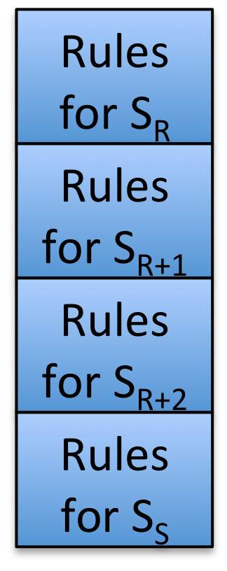
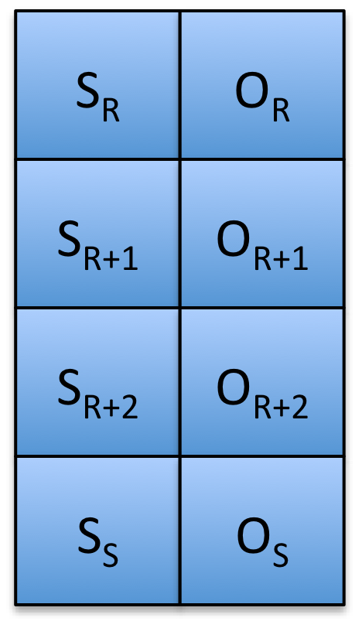
Path Evaluation
To evaluate the path taken by a message:
Each message is extracted from the message packet
Signatures are validated
The pairs <S_{i},O_{i}> for each hop are combined into a path
The rule sets are evaluated from newest to oldest against the path
If the rule sets do not eliminate the path, the message is placed in the appropriate orbit for that path based on the policies of the receiving STS
✓
✓
✗
✗

Slide 193
Path Caching
Three path caches are used to retain and update state information about relationships with other entities, and to improve performance
Received Query Cache: Caches path query messages received from other STSs. Cached messages are used to update the trust network
Update Path Cache: Caches all path, and their subpaths, received from other STSs. This is the set of all STSs that trust the local entity sufficiently
Trusted Path Cache: Caches all of the paths that the local STS considers sufficiently trusted in a specific context

