Slide 1
Trust, Identity, and Anonymity
LLNL Technical Seminar
Dr. Michael Clifford
March 6th, 2017

Slide 2
About This Talk
This talk is about my Ph.D. work:
  School: UC Davis (Computer Security Lab), 2012
  Advisor: Professor Matt Bishop
  Committee: Matt Bishop, Karl Levitt, Sean Peisert
Due to time limitations, I will only cover a subset of this work
This talk is NOT related to my current research or employer

Slide 3
Dissertation Research Plan
Exploration of identity within the Solar Trust Model led to new discoveries on relative anonymity and identity, and to 7 new classes of identity and anonymity attacks
Plan:
Formalization of the Solar Trust Model
Ensuring the model’s resilience against implementation attacks through proofs and modifications
Development of a theoretical framework for identity and anonymity
Development new classes of identity and anonymity attacks and countermeasures
Notes:
My Ph.D. research advanced my work on the Solar Trust Model, which combines features of authentication models, such as PKIs, with those of recommendation systems, social networks, and ad-hoc networks, into a context-sensitive, distributed trust and authentication model.
[SLIDE TEXT]

Slide 4
Presentation Outline
Trust and Anonymity Problems
Property-Based Identities
Distinguishing Identities
Relative Anonymity
Property-Based Attacks
Using the Solar Trust Model to Validate Identity Properties
Future Work
Conclusion and Questions
Notes:
To determine the trustworthiness of an entity, it is critical to be able to identify it. By establishing properties of identities, it is possible to prove several theorems
about how identities can or can not be distinguished. Building on this, we can use the manipulation of the properties of an entity as perceived by a specific observer, to manipulate the observer’s views of identity and anonymity with respect to that entity. This forms the basis for property-based attacks. Utilizing the Solar Trust Model, the observer can determine the degree of trust that they can associate with the entity’s properties.
[BRIEFLY GO THROUGH TOPICS IN OUTLINE HERE]

Slide 5
Presentation Outline
Trust and Anonymity Problems
Property-Based Identities
Distinguishing Identities
Relative Anonymity
Property-Based Attacks
Using the Solar Trust Model to Validate Identity Properties
Future Work
Conclusion and Questions
Notes:
First I will discuss problems in trust and anonymity.

Slide 6
Definitions
Trust | The degree of confidence that an observing entity has that another entity will meet a particular set of requirements
Identity | Uniquely specifies a particular entity
Anonymity | The condition in which an observer can not assign a unique identity to a specific entity
Notes:
Some of the terms that I use in this talk have many meanings in both common usage and the literature. Throughout the talk, I will be referring to trust, identity, and anonymity using these specific definitions.
[GO TO SLIDE TEXT HERE]

Slide 7
Problems
Trust | How much can an observer trust information used to verify an identity?
Identity | How do you learn and verify the identity of an entity?
Anonymity | How do you prevent an entity’s identity from being revealed?
Notes:
With respect to these definitions, we can ask some basic questions. For example,
[GO TO SLIDE TEXT HERE]

Slide 8

A Real World Trust Problem
Someone claiming to be Alice uses a phone to purchase an item
How much can we trust that Alice performed the transaction?
Notes:
Let’s look at a real world trust problem.
[GO TO SLIDE TEXT HERE]

Slide 9
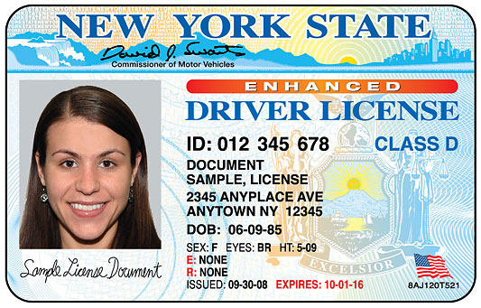
A Real World Identity Problem
Someone needs access to a system
The person’s ID claims they are Alice
How do we know the ID correctly identifies Alice?
Notes:
A similar problem arises in the real world with respect to identity.
[GO TO SLIDE TEXT HERE]

Slide 10
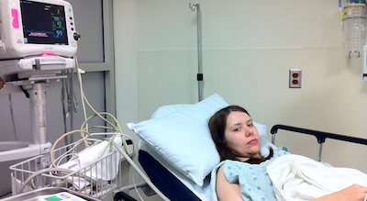
A Real World Anonymity Problem
A patient in a hospital
Doctors and family: OK to see the patient’s identity
Everyone else: Not OK to see the patient’s identity
Notes:
Likewise, we can consider a real world anonymity problem.
Consider a patient in a hospital.
In order to receive treatment, the patient must not be anonymous from the perspective of her doctors.
However, she must be anonymous from the perspective of random observers outside of the hospital, in order to protect her privacy and comply with HIPPA regulations.

Slide 11
Problems with Identity Models
Prior identity models assumed that an entity could be identified globally using a single identity.
But…
Identities are subjective, not objective.
Identities are dynamic, not static.
Need a way to model entities with identities that are subjective and dynamic:
Property-based Identities
Notes:
Previous work into identity models by other researchers made the assumption that entities had a single, globally applicable identity.
However, I will show shortly that Identities are subjective, not objective, and that they are dynamic, not static.
In order to model entities with subjective and dynamic identities, I developed property-based identities.

Slide 12
Presentation Outline
Trust and Anonymity Problems
Property-Based Identities
Distinguishing Identities
Relative Anonymity
Property-Based Attacks
Using the Solar Trust Model to Validate Identity Properties
Future Work
Conclusion and Questions
Notes:
Let’s explore property-based identities.

Slide 13
My Approach
Property-based Identities

Slide 14
Describing Properties
Key = Make
Value = Toyota
p₁ = (Make, Toyota)
Notes:
A property consists of a (key, value) pair.

Slide 15
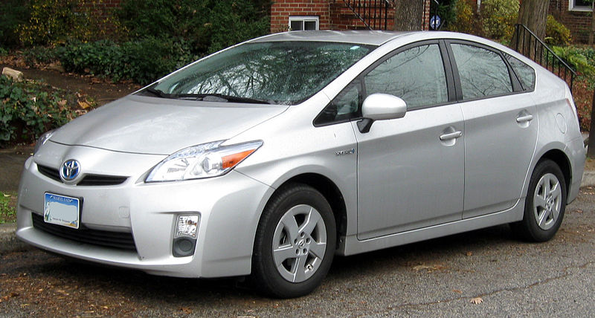
Defining Identities
Identity of a car:
p₁ = (make, Toyota)
p₂ = (model, Prius)
p₃ = (year, 2012)
p₄ = (color, silver)
p₅ = (registered in, MD)
p₆ = (license plate, ABC 123)
Notes:
Entities can be identified using a subset of their properties. For example, here are some of the properties that could be used to uniquely identify a specific Toyota Prius.

Slide 16

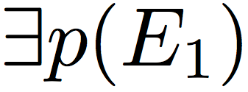
Characteristics Required for Properties
Existence
Notes:
A property must have certain characteristics in order for an observer to use it to uniquely define an entity.
First, the property must exist with respect to the observed entity.
For example, some devices have keyboards, and some do not. If a property represents the color of a physical keyboard, it can be used to distinguish
between two desktop PCs, but not between two iPads, since the iPad does not have a physical keyboard.

Slide 17
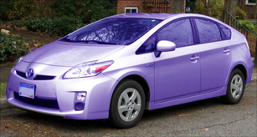
Mutual Exclusivity
Notes:
Second, a property can not be used to distinguish between two identities unless each identity has a different value associated with that property.
For example, three of these cars can not be distinguished using their color property because they all have the same value, silver. But the
purple car can be distinguished from the others, because it has a different color value.

Slide 18
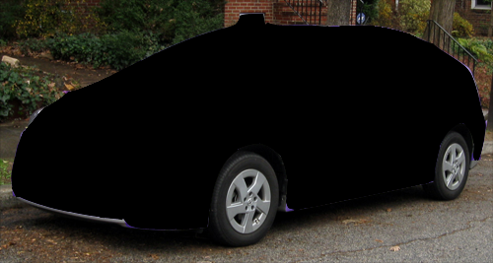
Readability
Notes:
Third, a property must be readable in order to be used to identify an entity. In this illustration, the value of the property “color” for this car is
not readable by the observer. Therefore, it can not be used to distinguish this car from other entities.

Slide 19

Association
Red hair
5’6”
130 lbs
Alice
?
128.120.255.201
Notes:
Finally, there must be a binding between property values and the entity being identified.
For example, this passport binds biometric data about Alice to an assertion of Alice’s identity. If you trust this
binding, you should trust the assertion that Alice has red hair, is 5’6”, and weighs 130 lbs. Conversely, there
is no binding between an IP address and a user. Therefore, an IP address can not be used to uniquely identify Alice.

Slide 20
Identifying Properties
P₂
P₇
P₁
P₅
P₆
P₃
P₄
Notes:
Entity E has a set of identifying properties.
This is the set of properties that can be used to describe E from the perspectives of observers, or in a claim made by E about its own identity.
Note that an observer may perceive that entity E has a certain property, or a property with a certain value, when in fact it does not.
(Example: Might misperceive a wolf as a dog from a distance.)

Slide 21

Entity E’s Claimed Identity
P₂
P₇
P₁
P₅
P₆
P₃
P₄
Notes:
Each identity associated with entity E is composed of a subset of its identifying properties (such as those shown here in green).
We are concerned with two particular sets of identities: Those that Entity E claims to have, and those that Entity E is perceived to have by an observer.
The entity’s claimed identity (Bruce Wayne) is composed of a a subset of the entity’s full set of identifying properties.

Slide 22

Entity E’s Perceived Identity
Observer
P₂
P₇
P₁
P₅
P₆
P₃
P₄
Notes:
Entity E’s perceived identity is the identity that Observer O perceives or measures E to have, based on the subset of E’s identifying properties that it can read.
This may be different than the identity that E claims to have.
For example, in this case, our observer perceives that E has the identity “Bruce Wayne” rather than the identity “Batman”.

Slide 23
Identities are Subjective
P₂
P₇
Observer 1
P₁
P₅
P₆
P₃
P₄
P₂
P₇
Observer 2
P₁
P₅
P₆
P₃
P₄
Different observers perceive different properties
Notes:
As I mentioned earlier, identities are both subjective and dynamic. Here’s what that means.
First, to see that identities are subjective, consider two observers, Observer 1 and Observer 2.
if the subset of properties readable by Observer 1 is different from the subset of properties readable by Observer 2,
then the identities perceived by the two observers will not be the same.

Slide 24
Identities are Dynamic
Properties change over time, making identities dynamic
Notes:
Now, to see that identities are dynamic, consider again the example of Bruce Wayne.
By changing his clothing and voice, Bruce Wayne can make an observer perceive his identity to be Batman, not Bruce Wayne.
Because properties can change over time, identities are dynamic.

Slide 25
Presentation Outline
Trust and Anonymity Problems
Property-Based Identities
Distinguishing Identities
Relative Anonymity
Property-Based Attacks
Using the Solar Trust Model to Validate Identity Properties
Future Work
Conclusion and Questions
Notes:
Now I am going to talk about three theorems that describe when identities can and can not be distinguished.

Slide 26
Equivalence Theorem
Observer
P₁ = (Color, silver)
P₂ = (Color, silver)
Notes:
First, EQUIVALENCE: If two properties are the same, then they can’t be used to distinguish the perceived identities of two entities from the perspective of the same observer.

Slide 27
Observability Theorem
Observer
P₁ = silver
P₂ = ?
Notes:
Second, OBSERVABILITY: The observer can read property P1 (the color of car 1), but can not read property P2 (the color of car 2), because car 2 is behind a wall. Therefore, color can not be used to distinguish the identities of these two vehicles.

Slide 28
Uniqueness Theorem
P_{yellow} _{spot} = true
P_{yellow} _{spot} = false
Notes:
And third, UNIQUENESS: If an observer perceives a value for a property of identity 1, and there is no corresponding property with the same value for identity two, then perceived identities 1 and 2 with respect to observer O must be different.
For example, These cars both have a “yellow spot” property. For car 1, the property is true. For car 2, it is false.
Since the two cars have different values for the yellow spot property, then the observer must perceive the cars to have different identities.

Slide 29
Presentation Outline
Trust and Anonymity Problems
Property-Based Identities
Distinguishing Identities
Relative Anonymity
Property-Based Attacks
Using the Solar Trust Model to Validate Identity Properties
Future Work
Conclusion and Questions
Notes:
Next I’ll discuss limitations in prior models of anonymity, and how those limitations can be overcome using relative anonymity.

Slide 30
Problems with Anonymity Models
Prior anonymity models assumed an entity was:
  Either anonymous globally, or not at all
  Indistinguishable from other members of an anonymity set (a set of indistinguishable entities)
  Identifiable if k-anonymity is violated
I developed a model (relative anonymity) where anonymity:
  Is relative to the observer
  Depends on observable properties
  Varies with the identity being observed
Notes:
Existing work on anonymity falls into several broad classes. Many authors discuss group anonymity. Syverson and Stubblebine [Syv99] define a (group) principal as any entity that may have taken an action, generated a message to another principal, or received a message from another principal. They describe a formal language that specifies whether a set of principals knows something about another principal, or about a message from another principal. The group principal has some required knowledge if the knowledge exists within some Boolean combination of principals within the group. It may also exist collectively if it is contained within the union of the principals in the group. When a group principal attempts to determine the identity of another principal, it is called an intruder. A principal remains anonymous to an intruder if the intruder does not have sufficient knowledge to identify the principal. Otherwise, it loses anonymity. They note that each intruder may have different knowledge of a target principal. Our approach addresses what that knowledge is (an identity of an entity defined in terms of its claimed and perceived properties), how those properties vary relative to each observer, and how they can be manipulated and used in attacks. The two approaches are complementary. A group of observers can combine their observations of the properties of an entity to derive an identity for the entity that the entire group agrees on.
Groups may also work together to preserve their anonymity. Ateniese et al. [Ate00] describe a method by which a group signature can be applied to some information. Using this signature, an observer can determine that the information was signed by some member of a group, but cannot determine which member performed the signing. The members of the group also cannot collectively determine who the signer was. However, a distinguished “group manager”, who controls group membership, can prove who the signer was if necessary.
Other research focuses on how to keep an entity anonymous with respect to all observers. Pfitzmann and Waidner [Pfi87] distinguish several different types of anonymity. Sender anonymity describes the case in which it is not possible to determine who sent a message. Likewise, recipient anonymity describes the case in which it is not possible to determine the intended recipient of a message. Chaum [Cha81] defines untraceability in the context of a relation between a sender and receiver as expressed through their communications; it holds when they remain anonymous to third parties, who are unable to observe that relation.
A variation of this, unlinkability [Pfi01], prevents a link from being made between an identifier and an item. This work does not address cases in which some observers must know the identity of an entity, while other observers must not know that identity, as in the medical example. Nor does it address the case of multiple claimed or perceived identities, as in the spy example.
A variant of this work combines this with group anonymity to prevent an anonymous entity from being distinguished from other entities. Chaum’s Dining Cryptographers problem [Cha88] describes this in terms of anonymity sets, which are sets containing entities that cannot be distinguished from each other by outside observers. For example, given the set {Alice, Bob, Charlie}, if Alice sent a message, an observer could not determine whether Alice, Bob, or Charlie sent it. Similarly, k-anonymity [Swe02] describes a kind of anonymity in which some object cannot be distinguished from k − 1 other objects. Anonymity sets can change over time, and successive anonymity sets may overlap or be disjoint [Ked03]. This problem is somewhat different in that it focuses on anonymity with respect to a group and not on the perception of the observers.
As actions of anonymous entities are observable, some research tries to identify entities with a certain probability based on their actions. For example, Halpern and O’Neill [Hal05] describe a mathematical framework in which, given that some agent within an anonymity set took some action, the probability that a specific agent took that action can be determined by an observer. The agent is identified based on what they have been seen doing, not on their properties— and actions and properties are fundamentally different. To see the difference between actions and properties, consider three parked cars, one of which is red, another blue, and the third silver. All the cars are identical except for the value of the property called “color”. All of the cars are parked so they cannot be distinguished by their action (being still). But an observer can easily distinguish the cars simply by observing the value of the property “color” for each car. This paradigm may be appropriate for detecting spies, as a spy might be distinguished from non-spies by his or her actions. But where actions are not observable, or cannot be distinguished, one needs to identify entities by their properties.
In our approach, relative anonymity, the set of properties that each individual observer perceives the observed entity to have, determines whether an entity is anonymous to that individual observer. Unlike existing approaches, relative anonymity depends the information available to the observer. Relative anonymity does not depend on the actions taken by an entity, but rather on whether some property makes the entity unique to a particular observer.
Relative anonymity has several significant differences from existing approaches. First, because anonymity is viewed from the perspective of each individual ob- server, relative anonymity can model situations in which an entity is anonymous relative to one observer, but not to another, such as in the medical privacy ex- ample. Anonymity sets do not model this because the anonymity set would be different for each observer. Second, it uses a more general definition of identity than the quasi-identifier used by k-anonymity, because the properties used to identify one entity may differ from the properties used to identify another entity. Relative anonymity also deals with different views of identities—those claimed by observed entities, and those perceived by their observers—a distinction not made in other approaches. Additionally, each entity can claim to have multiple identities, which can be used as aliases or to prevent two observers
from correlating information about that entity. Each observer can also assign multiple perceived identities to one entity based on contexts such as the role of the entity, or on observations of the entity obtained from different information sources. They may also dynamically add, delete, or modify identities of an entity. Finally, these identities can be based on any observable (or perceived) property of an entity, rather than those that have been pre-defined.

Slide 31
Properties
Property = (key, value)
P₁ = (height, 65 cm)
Notes:
To explain relative anonymity, we start with some definitions.
A property is a key, value pair.

Slide 32
Observer
Observer
Properties observed:
p₁ = (make, Toyota)
p₂ = (model, Prius)
p₃ = (year, 2012)
p₄ = (color, silver)
p₅ = (registeredin, CA)
p₆ = (licenseplate, ABC 123)
Observer reads properties of entities
Notes:
An observer is something such as a sensor or a person that can read the properties of entities.

Slide 33
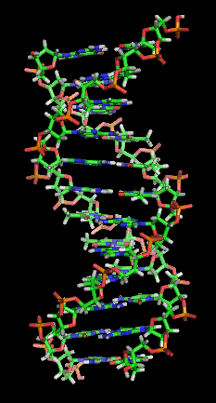
Constant Property
Notes:
A constant property is a property that an entity has for the period of interest, regardless of when it is observed. For example, although DNA can mutate slowly over time, it remains sufficiently constant over time that it can be used for identification.

Slide 34


Attacker
Identity = James T. Kirk
Identity = James T. Kirk?
Notes:
An attacker, when discussing identities, is any entity that attempts to alter, reveal, anonymize,
or duplicate the set of properties perceived by a given observer, contrary to the policies and intentions of the observed entity.
Note: An observer is not necessarily an attacker, but an attacker may be an observer.

Slide 35
Relative Anonymity
Car 1
Car 2
Observer 1
Car 1 is relatively anonymous to Observer 1
Observer 2
Car 1 is not relatively anonymous to Observer 2
Notes:
In relative anonymity, an entity can be anonymous relative to one observer, but not to another.
For example, on their right side, both cars have identical properties and values. Because Observer 1 can only see the cars
from their right side, car 1 is relatively anonymous to Observer 1.
On their left sides, car 1 has a true “yellow spot” property, whereas car 2 has a false yellow spot property. Observer 2 sees
both cars from their left sides. Because Observer 2 can read different values for the properties of the two cars, Observer 2
perceives them to have different identities. Therefore, Car 1 is not relatively anonymous to Observer 2.

Slide 36
Presentation Outline
Trust and Anonymity Problems
Property-Based Identities
Distinguishing Identities
Relative Anonymity
Property-Based Attacks
Using the Solar Trust Model to Validate Identity Properties
Future Work
Conclusion and Questions
Notes:
The use of relative anonymity allows us to identify classes of property-based attacks on anonymity and identity. I will describe several of these attacks, and how to prevent the attacks by preventing the pre-conditions required for the attacks to occur from becoming true.
Note that preventing pre-conditions for attack classes from becoming true can be applied to other forms of attacks, not just to attacks on anonymity and identity.

Slide 37
Participants in Property-Based Attacks
V
A victim entity
A
An attacker
O
An observer
Notes:
In these attacks, we have several participants:
A victim entity, V, whose identity or anonymity is being attacked.
An attacker, A, who is attempting to alter the identity or anonymity of the victim, relative to the observer.
An observer, O who is attempting to determine the identity of the victim.

Slide 38
Property Exposure Attack Example
Victim is a hospital patient
Victim’s hospital records must remain private
Victim is anonymous relative to outsiders, but not to doctors
Attacker reveals victim’s unique hospital patient ID to at least one outside observer
Victim is no longer anonymous relative to that observer
Notes:
Our first example of a property-based attack is a property exposure attack. Here is an example of how this attack works.
[USE SLIDE TEXT HERE]

Slide 39
Property Exposure Attack on Anonymity
E₃
E₂
E₄
?
V
O
E₅
Goal: Reveal a unique property of V to O
This breaks the anonymity of V relative to O
Notes:
In general, in a Property Exposure Attack on Anonymity, the goal of the attacker is
to reveal a unique property of the victim to the observer.
This breaks the anonymity of the victim to the observer.

Slide 40
Property Exposure Attack on Anonymity
E₃
E₂
E₄
?
V
O
E₅
Initially, the victim is anonymous to the observer
Notes:
Let’s step quickly though the attack.
Initially, the victim is anonymous to the observer, because the observer can not read a property
that distinguishes it from the other entities that are visible to the observer.

Slide 41
Property Exposure Attack on Anonymity
E₃
A
E₂
E₄
V
Entity is blue
O
E₅
The attacker exposes a unique property of V to O
Notes:
The attacker then exposes a unique property of the victim to the observer.
In this case, the attacker exposes the fact that the victim is blue to the observer.

Slide 42
Property Exposure Attack on Anonymity
E₃
A
E₂
E₄
V
Entity is blue
O
E₅
V’s identity relative to O is now unique, so the attack succeeds
Notes:
The victim’s identity relative to the observer is now unique.
Consequently, the observer can distinguish between the victim and the other nodes,
so the attack succeeds

Slide 43
Preventing the Attack
Prevent O from reading V’s unique property
Prevent attacker from transmitting or revealing V’s unique property
Expose the same property for multiple entities, thus preventing V’s property from uniquely identifying it
Notes:
How do we prevent the attack? We can prevent it by preventing the preconditions necessary for the attack to occur from becoming true.
[READ LIST OFF SLIDE.]

Slide 44
False Property Attack Example
Bob wants to harm Alice
Bob steals Alice’s passport and replaces it with that of Eve, a known criminal
Alice goes to the airport with the fake passport
Alice’s passport says she is Eve, so security arrests her
Attack is prevented if Alice protects her passport, or if security can validate the binding of the passport to Alice
Notes:
Our next example is of a False Property Attack.
[USE SLIDE TEXT HERE]

Slide 45
False Property Attack on Identity
V
I’m Alice!
O
Goal: Convince observer that victim has a false property
Alters victim’s observed identity, potentially ends anonymity
Notes:
Here is how the general attack works.
The goal of the attacker is to convince the observer that the victim has some false property.
If successful, this will alter the identity that the observer assigns to the victim, potentially ending the victim’s anonymity.

Slide 46
False Property Attack on Identity
V
I’m Alice!
O
The victim (Alice) claims to be Alice
Notes:
Initially, the victim correctly claims that she is Alice.

Slide 47
False Property Attack on Identity
A
You’re Bob!
V
I’m Alice!
O
Attacker alters Alice’s properties or generates fake properties for Alice
Notes:
The attacker then alters Alice’s properties or generates fake properties for Alice. In this case,
the attacker makes Alice appear to be Bob to the observer.

Slide 48
False Property Attack on Identity
A
V is really Bob
V
I’m Alice!
O
Attacker convinces observer that the altered properties are valid
Notes:
The attacker convinces the observer that the altered properties are valid, so the observer
now believes that Alice is actually Bob.

Slide 49
Preventing the Attack
Prevent attacker from generating or altering properties of an entity other than itself
Enable observer to validate victim’s properties
Victim prevents alteration of its own properties by adequately protecting them
Notes:
To prevent the attack, we can…
[READ THE REST FROM THE SLIDE]

Slide 50
Suspicious Group Attack Example
Alice and Bob are spies
Alice’s government wants Bob’s government to be discredited in negotiations with Charlie’s government
Alice obtains a weapon identical to one used by Bob’s government, adding appropriate markings as necessary
Alice attacks Charlie’s government with the weapon
Charlie’s government believes it was attacked by Bob’s government, not Alice’s
Notes:
The last example of a property-based attack that I’m going to cover is the suspicious group attack.
Here’s how it works
[GO TO SLIDE TEXT]

Slide 51
Suspicious Group Attack
E₃
E₂
E₄
A
O
E₅
Goal: Attacker anonymously behaves maliciously to convince observer an anonymity set member was responsible
Notes:
In this attack, the attacker anonymously behaves maliciously in order to convince an observer that
an anonymity set member was responsible.
As a reminder, an anonymity set is a set containing entities that cannot be distinguished from each other by outside observers.

Slide 52
Suspicious Group Attack
E₃
E₂
E₄
A
O
E₅
Anonymity set including attacker can be observed by O
Notes:
Here’s how the attack works.
The anonymity set, which include the attacker, can be observed by the observer.

Slide 53
Suspicious Group Attack
E₃
E₂
E₄
A
O
E₅
Attacker behaves maliciously. O sees this and identifies attacker.
Notes:
Normally, if the attacker behaves maliciously, the observer will see this and identify attacker.
For example, if the attacker yelled in a crowd, it would be easy to identify them.

Slide 54
Suspicious Group Attack
E₃
E₂
E₄
A
O
E₅
If attacker retains anonymity relative to the observer, the observer can not tell who in the group is malicious
Notes:
But if the attacker retains anonymity relative to the observer, the observer can not tell who in the group is malicious.
For example, if there were a wall between the observer and the anonymity set, the observer would know that someone in
The anonymity set yelled, but would not be able to determine who. This would cast aspersion on the entire group, and
potentially reduce the observer’s trust in the entire group.

Slide 55
Preventing the Attack
Prevent attacker from becoming a member of the anonymity set
Develop a way to detect the unique properties of a malicious actor
Notes:
To prevent this attack, we can:
Prevent attacker from becoming a member of the anonymity set
Develop a way to detect the unique properties of a malicious actor

Slide 56
Property Based Attack Summary
Expressed anonymity and identity in terms of the claimed and observable properties of an entity, as viewed from the perspective of individual observers
Developed attacks based on these properties
Attackers can manipulate anonymity and identity from the perspective of individual observers
Notes:
To summarize property based attacks:
1) Anonymity and identity can be expressed in terms of the claimed and observable properties of an entity, as viewed from the perspectives of individual observers
2) Based on these properties, attacks were developed.
3) Because anonymity and identity are evaluated relative to the observer, attackers can manipulate them from the perspective of specific observers.

Slide 57
Presentation Outline
Trust and Anonymity Problems
Property-Based Identities
Distinguishing Identities
Relative Anonymity
Property-Based Attacks
Using the Solar Trust Model to Validate Identity Properties
Future Work
Conclusion and Questions
Notes:
The last topic that I’m going to cover is the use of the Solar Trust Model to validate identity properties.
As I mentioned previously, this is a trust model that I developed that combines features of authentication models, such as PKIs, with those of recommendation systems, social networks, and ad-hoc networks, into a context-sensitive, distributed, trust and authentication model.

Slide 58
Can We Trust Property Assertions?
“Eve has a valid passport”
Alice
Bob
Eve
58
Should Alice believe Bob’s assertion?
Notes:
The first thing that we need to ask is whether we can trust specific property assertions.
For example, If Eve presents a passport to Bob, and Bob claims to Alice that Eve has a valid passport, should
Alice believe him?

Slide 59

Choosing Between Assertions
“Eve has a valid passport”
Alice
Bob
Eve
“Eve has a fake passport”
Alice
Dave
Eve
59
Which assertion is more credible to Alice?
Notes:
What if Alice has to choose between contradictory assertions about Eve’s properties, one by Bob, and one by Dave?
Which assertion is more credible to Alice? To what extent can Alice trust each assertion?

Slide 60

Equivalence
“Eve has a valid passport”
Alice
Bob
Eve
“Eve is a doctor with a valid driver’s license”
Alice
Dave
Eve
60
Are sets of properties of equal importance?
Notes:
What if Bob and Dave make assertions about different properties of Eve’s identity?
For example, Bob says Eve has a valid passport, and Dave says Eve is a doctor with a valid driver’s license.
Is each set of properties of equal importance?

Slide 61
Trust is Context Dependent
“Eve has a valid passport”
Alice
Bob
Eve
“Eve is a doctor”
Alice
Dave
Eve
61
Is Alice at an airport or a hospital?
Notes:
The answer illustrates that trust is context dependent.
If Eve is at an airport, her passport matters, but her medical credentials do not, because airport security trusts passports, but not medical credentials.
If Eve is at a hospital, the staff likely trusts her medical credentials to assert that she is qualified to practice medicine more than an assertion of her citizenship.
NOTE: REINFORCEMENT LEARNING COULD BE USED TO SELECT OPTIMAL WEIGHTS FOR PROPERTIES IN DIFFERENT CONTEXTS.
THIS WOULD BE FUTURE WORK.

Slide 62
Trust Decisions are Subjective
I only trust users I’ve met before
Alice
Bob
Eve
I trust the users that Dave trusts if Dave validates their identity
Greg
Dave
Eve
62
How do we handle different criteria for trust among users?
Notes:
Trust decisions are subjective?
For example, Alice only trusts assertions from users whom she has met previously.
Greg trusts anyone, so long as Dave validates their identity first.
How do we handle different criteria for trust among users?

Slide 63
How Does Provenance Affect Trust?
Alice
Bob
Greg
Dave
Eve
Fake Eve
63
How do we handle different criteria for trust among users?
Notes:
Similarly, how does provenance affect Trust?
For example, if Alice trusts Bob to validate passports more than Greg, should she trust Bob’s claims about
Eve’s identity more than Greg’s? What if Greg asserts that Fake Eve is Eve? To what extent should she trust Greg’s assertion?

Slide 64
Example
0.9
0.75
C
A
B
C
B
Initially, A trusts B to validate passports
B places C’s passport in orbit 0.75
64
Notes:
To answer these questions, we can use the Solar Trust Model. I’m going to do a quick example to show how the model works,
and then I’ll explain what is happening. We have three entities, A, B, and C. Each entity has a set of orbits. Each orbit represents a set of
entities that are trusted equally in the same context. Orbits are ordered by their label.
Emphasize that the ordering is important

Slide 65
Example
0.9
0.75
C
A
B
C
B
C shows B a fake passport
65

Slide 66
Example
0.1
0.9
0.75
C
A
B
C
B
If B detects it, B reduces its trust in passports shown by C, possibly rendering them untrusted
66

Slide 67
Example
0.9
0.1
C
A
B
C
B
A no longer has a path to C, so C’s passport is untrusted by A
67

Slide 68
Example
0.9
0.75
C
A
B
C
B
If B does not detect it, A’s experience with C’s passport won’t match B’s recommendation
68

Slide 69
Example
0.9
0.75
C
A
0.4
B
B
C
A reduces its trust in B, possibly causing A to no longer trust C
69

Slide 70
Example
0.4
0.75
C
A
B
C
B
Eventually, C’s reputation may force it off of the network
70

Slide 71
Entities
Entity
An entity is something in the Solar Trust Model
71
Notes:
Example: An entity might be another user, a public key, a Solar System, an STS, an organization, a concept, or the solution to a particular problem.

Slide 72
Trust
Trust(Observing Entity, Observed Entity, Context) = Degree of Trust
Trust is relative
The degree of confidence that someone has that something will meet a particular set of criteria.

Slide 73
Context
The set of information used in making a trust judgment
A set of constraints on the applicability of the scope of that trust judgment
Analogous to an agent’s environment in machine learning

Slide 74
Solar Trust Server (STS)
STS
A server that acts as a proxy for a user and implements their trust policies
74

Slide 75
Trust Levels
A
B
C
D
E
F
Disjoint sets of objects that are trusted to the same degree in the same context
75

Slide 76
Dense Trust Levels
A
B
C
D
0.7
E
F
0.65
G
H
I
J
0.6
Labeled using a dense set to allow insertion of any number of intermediate trust levels
Notes:
Trust levels are labeled using a dense set to allow insertion of any number of intermediate trust levels.
Note that the value of a label is used only to create an ordering of trust levels.
A label of 0.7 is NOT 0.1 more than a label of 0.6. It is simply has a higher position in the ordering.

Slide 77
Labels of Trust Levels are NOT Values
The value of a label is used only to create an ordering of trust levels.
A label of 0.7 is NOT 0.1 more than a label of 0.6. It is simply has a higher position in the ordering.
A
B
C
D
0.7
G
H
I
J
0.6
77
Notes:
Note that the value of a label is used only to create an ordering of trust levels.
A label of 0.7 is NOT 0.1 more than a label of 0.6. It is simply has a higher position in the ordering.

Slide 78
Orbit
A set of entities at the same trust level in context C
78
Notes:
An orbit is a set of entities that are trusted to the same extent by the user in the same context.
Within an orbit, entities are not ordered relative to each other.

Slide 79
Orbits
Each orbit represents a different level of trust
79
Notes:
Given a specific context, each orbit represents a different level of trust into which entities are mapped.
In a different context, the set of orbits, and the mapping to those orbits, may be different.

Slide 80
Solar Systems
Entities (planets) mapped to different orbits
1.0
Completely trusted orbit (contains the STS and completely trusted entities)
0.8
0.62
Minimally trusted orbit (M)
0.43
0.0
Orbit number (O)
Completely untrusted orbit
An ordered set of disjoint orbits
Defined in a certain context by a given user
80
Notes:
All of a user’s orbits, with respect to a specific context, are combined into a Solar System.
A solar system is an set, ordered by label, of disjoint orbits.
The Solar System is defined in a certain context by the user.
[IDENTIFY THE PARTS OF THE SOLAR SYSTEM IN THE ILLUSTRATION]

Slide 81
Solar Systems
1.0
0.8
Orbit number (O)
0.62
0.43
0.0
Given: O_{i} and O_{j} are orbits
Trust is ordered by orbit label
81
Notes:
Within a Solar System, trust is ordered by orbit label.
So to be clear, orbits are ordered by label, and the entities within those orbits are partially ordered
relative to the other entities in the Solar System, based on the extent to which they are trusted in a given context.

Slide 82
Minimally Trusted Orbit
1.0
0.8
0.62
Minimally trusted orbit (M)
0.43
0.0
Completely untrusted orbit
An entity must be in an orbit ≥ the minimally trusted orbit in a given context to be trusted by the user
82
Notes:
The minimally trusted orbit is special, because an entity is considered sufficiently trusted in a given context
if and only that entity is an an orbit with a label at least as high as that of the minimally trusted orbit

Slide 83
Policies
1.0
0.8
0.62
0.43
0.0
A policy generates <solar system, orbit> assignments based on specific properties and contexts
83
Notes:
Policies are functions that map entities to orbits.
A policy generates <solar system, orbit, context> assignment for an entity based on
the properties of that entity, and a specific context
(Could have one solar system with many contexts, or one context per system. That’s why the output tuple contains a context.)

Slide 84
Policies
+
Orbit 0.7
Orbit 0.4
Example: Greater authentication evidence provides greater trust for some users
84
Notes:
For example, in the context of authentication, a passport plus a driver’s license may be trusted more than a
driver’s license alone, because the combination provides stronger evidence of the entity’s identity than the
license alone does.

Slide 85
Relations
Given:
Alice is a brain surgeon
Context: brain surgery
Bob’s policy on brain surgery
Bob places Alice in orbit 0.9 in his
solar system in the brain surgery context
Given:
Alice is a brain surgeon
Context: auto repair
Bob’s policy on auto repair
Bob places Alice in orbit 0.2 in his
solar system in the auto repair context
Relations bind entities to orbits using policies
Notes:
A relation is a mapping of a entities to specific orbits in specific solar systems, based on a given policy.
[GO THROUGH EXAMPLE ON SLIDE]

Slide 86
Direct Relations
Given:
E_{R} and E_{S} are two entities
S_{R} is the solar system of E_{R}
E_{R} has a direct relationship with E_{S}
O_{i} is in an orbit of S_{R}
Alice
Bob
Based on what one entity knows directly about another
Unidirectional
86
Notes:
There are two types of relations.
A direct relation is based what one entity knows directly about another. For example, you most likely know your parents, friends, or children directly.
Relations are unidirectional. I may trust you more or less than you trust me in the same context.

Slide 87
Indirect Relations
Alice
Given:
P_{RS} is a path from E_{R} to E_{S}
I_{RS} is an indirect relation from E_{R} to E_{S}
Bob
Dave
Based on what one entity knows about another entity through intermediate parties in a given context
87
Notes:
An indirect relation is composed of a path of direct relations, based on what one entity knows about
another entity through intermediate parties in a given context
For example, Alice knows Bob directly, and Dave indirectly.

Slide 88
Paths
C
A
B
C
B
Represent trust relations
88
Notes:
Paths represent trust relations

Slide 89
Paths
C
A
B
C
B
Represented with an ordered set of pairs
89
Notes:
They are represented with an ordered set of pairs

Slide 90
Maximum Path Node Count
C
A
B
C
B
N=2
N=5
Each entity specifies the maximum node count (N) that it will accept in a given path
90
Notes:
Each entity specifies the maximum node count (N) that it will accept in a given path
A will not accept a path to C, because A will only trust paths with 2 or fewer nodes.

Slide 91
Sufficiently Trusted Direct Relations
1.0
0.8
Minimally
trusted orbit (M)
0.62
0.43
0.0
Occurs when an entity is in an orbit at least as trusted as the minimally trusted orbit in a given context
91
Notes:
In order for a path from one node to another to exist, the relation must be sufficiently trusted.
A sufficiently trusted direct relation occurs when an entity is in an orbit at least that is as trusted as the minimally trusted orbit in a given context

Slide 92
Sufficiently Trusted Indirect Relations
C
A
B
B
A path composed entirely of sufficiently trusted direct relations
92
Notes:
A sufficiently trusted indirect relation is a path path composed entirely of sufficiently trusted direct relations.

Slide 93
Sufficiently Trusted Indirect Relations
B
C
A
B
A trusts B sufficiently in its current context. B trusts C sufficiently in its current context (ex: medicine)
93
Notes:
For example, A trusts B sufficiently in its current context. B trusts C sufficiently in its current context (ex: medicine)
Note that the contexts of evaluation need not be the same on every hop.

Slide 94
Sufficiently Trusted Entities
Entities a given user can reach through a path
94
Notes:
Sufficiently trusted entities are entities that a given user can reach through a sufficiently trusted path

Slide 95
Messages
“Hello. I’m Bob”
Alice
Bob
Data sent from a sender to a receiver. Messages are trusted as much as the most trusted path to the sender.
95
Notes:
Messages are data, such as certificates, recommendations, and files, that are sent from a sender to a receiver.
Messages are trusted as much as the most trusted path to the “sender” (which might be a database or file, rather than a person).

Slide 96
The Path Discovery Problem
A
C
B
D
E
F
G
H
How can we securely find the DAG of all paths from a user to its sufficiently trusted entities?
96
Notes:
How can we securely find the DAG of all paths from a user to its sufficiently trusted entities?
This is the Path Discovery Problem

Slide 97
The Path Discovery Algorithm
A
A
C
Q1
C
B
B
D
E
D
E
F
G
H
F
G
H
A sends a path query message to its only sufficiently trusted direct relation, B
97
Notes:
We solve this using the path discovery algorithm.
[STEP THROUGH EXAMPLE ON SLIDES]

Slide 98
The Path Discovery Algorithm
A
A
C
D,E
Q1
C
B
B
D
E
D
E
F
G
H
F
G
H
B replies with its sufficiently trusted direct relations
98

Slide 99
The Path Discovery Algorithm
A
A
C
C
B
B
Q2
Q3
D
E
D
E
F
G
H
F
G
H
Repeat for D and E. E returns ∅ because it has no
sufficiently trusted direct relations
99

Slide 100
The Path Discovery Algorithm
A
A
C
C
B
B
F
∅
D
E
D
E
F
G
H
F
G
H
Repeat for D and E. E returns ∅ because it has no
sufficiently trusted direct relations
100

Slide 101
The Path Discovery Algorithm
A
A
C
C
B
B
D
E
D
E
Q4
F
G
H
F
G
H
The procedure repeats until the path from A terminates
101

Slide 102
The Path Discovery Algorithm
A
A
C
C
B
B
Sufficiently trusted children
of F
D
E
D
E
Q4
F
G
H
F
G
H
The procedure repeats until the path from A terminates
102
Notes:
The procedure repeats until the path from A terminates
Although not shown here, the query and response messages use a variety of techniques including message
signing, nonces, and key trust evaluation to ensure that trust assertions can not be manipulated by malicious nodes.
[IF ASKED, DISSERTATION SECTION 4.9 SHOWS HOW THIS IS DONE IN GREAT DETAIL.]

Slide 103
Paths From Different Entities Overlap
Q
A
C
R
B
D
E
F
G
H
Allows efficient path discovery and maintenance
Models real world relationships
103

Slide 104
Path Evaluation
Paths are trusted no more than the orbit in which they originate
Policies evaluate the properties of paths, further reducing their trustworthiness in some cases
104

Slide 105
Path Updates
A path update algorithm updates all affected paths when a direct relation changes
105

Slide 106
Path Aging
Paths monotonically decrease in trust over time unless refreshed
This reflects the decreasing relevance of old observations over time in determining trust
106

Slide 107
Evaluating Context
Each solar system interacts with the others using their own interpreted contexts
107

Slide 108
Authentication
An entity’s identity can be authenticated by its observable properties, such as a public key
That identity is trusted as much as the path to the identity
108

Slide 109
Certificate and Key Distribution and Revocation
Certificates and keys can be sent as messages
Trusted as much as the most trusted path to them
If Entity E has no sufficiently trusted path to a certificate or key, it is revoked from E’s perspective
109

Slide 110
Computational Scalability
  The number of relationships that anyone can have: O(nodes+edges)
  Limited by the maximum path node count of every node along each path.
Queries sent by each node: O(n)
Replies to queries: O(n)
Number of path updates sent when a relationship changes = number of paths that intersect the changed relationship: O(n)

Slide 111
Solar Trust Model Summary
The Solar Trust Model:
Addresses limitations in other trust models
Provides authentication, key distribution, and automatic revocation
Is resistant to property based attacks on identity

Slide 112
Presentation Outline
Trust and Anonymity Problems
Property-Based Identities
Distinguishing Identities
Relative Anonymity
Property-Based Attacks
Using the Solar Trust Model to Validate Identity Properties
Future Work
Conclusion and Questions
Notes:
Say verbally how these relate to each other

Slide 113
Future Anonymity and Identity Work
Develop methods of identifying the properties of an entity.
Property-based signature detection of attacks, viruses, and protocols.
Attacks that manipulate property-based signatures.
Automatic identification and classification of properties of attacks, viruses, and protocols (intrusion detection).
Determine how to tie this work to Attribute Based Access Control (ABAC)
Notes:
* Attribute Based Access Control uses Boolean expressions and conditionals to determine access rights based on the attributes of subjects, actions, resources, and contexts.
(See NIST SP 800-162, Guide to Attribute Based Access Control (ABAC) Definition and Considerations for details)

Slide 114
Future Trust Modeling Work
Exploration of statistical methods for use as policies
Use of reinforcement learning techniques to:
  Learn user preferences, in order to automatically assign entities to orbits.
  Learn optimal weights for identity properties in different contexts.

Slide 115
Presentation Outline
Trust and Anonymity Problems
Property-Based Identities
Distinguishing Identities
Relative Anonymity
Property-Based Attacks
Using the Solar Trust Model to Validate Identity Properties
Future Work
Conclusion and Questions
Notes:
Say verbally how these relate to each other

Slide 116
Trust Contributions
Developed the Solar Trust Model, which:
  Efficiently represents user-specific trust relations using a dynamic trust network
  Uses relative trust
  Efficiently discovers and updates sufficiently trusted trust paths
  Can be used for recommendations, authentication, key and certificate distribution and revocation
  Does not require trust in a central trust authority
Showed how observers can determine how much they can trust identity information using the Solar Trust Model

Slide 117
Identity Contributions
Developed a theory of property based identities
Showed that identity is relative
Developed new classes of attacks that manipulate identities relative to given observers
Found ways to prevent identity manipulation

Slide 118
Anonymity Contributions
Built on property-based identities to develop relative anonymity
Developed new classes of attacks that violate relative anonymity
Developed methods to prevent identities from being revealed

Slide 119
Questions

Slide 120
Backup
Slides

Slide 121




Summary of Equations
Number | Description | Equation
1 | Existence
2 | Mutual Exclusivity
3 | Identifying Properties
4 | Claimed Identity
5 | Perceived Identity
6 | Observers in the same partition see the same properties
7 | Identity is subjective and dynamic
8 | Relative Anonymity
9 | Anonymity depends on observer partition

Slide 122
Anonymity Related Work

Slide 123
Group Anonymity

Slide 124
Group Signatures
Observer
Signed by someone
In this group

Slide 125
Sender Anonymity
Observer
Sender = ?
Recipient = Bob

Slide 126
Recipient Anonymity
Observer
Sender = Alice
Recipient = ?

Slide 127
Untraceability
Observer
Sender = ?
Recipient = ?

Slide 128

Unlinkability
Observer
Name= ?
Recipient = ?

Slide 129

The Dining Cryptographers Problem
Alice
Charlie
Bob
Dave

Slide 130
k-Anonymity
k indistinguishable objects

Slide 131
Probabilistic Anonymity
Name | Probability
Alice | 0.75
Bob | 0.05
Charlie | 0.2

Slide 132
Anonymity Set
Observer
Message may have been sent by Alice, Bob, or Charlie
Charlie
Alice
Bob

Slide 133
Solar Trust Model Related Work

Slide 134
A Trust Example
How trustworthy is a message from a user?

Slide 135
Interoperability
CA₁
CA₄
CA₂
CA₃
CA₅
CA₆
User₁
User₂
User₃
User₄
User₅
Organization 1’s PKI
Organization 2’s PKI
A tale of two PKIs

Slide 136
The Interoperability Problem
Unrelated organizations do not share common authentication or trust policies
Organizational, cultural, and political boundaries prevent mutual acceptance
Diminishes interoperability between commercial, civil and military organizations

Slide 137
Biba’s Scalability Across Organizations
Object at Higher Integrity Level
Organization 1
Object at Higher Integrity Level
Organization 2
✗ Read
✗ Read
Subject
Object at Same Integrity Level
Subject
Object at Same Integrity Level
No reads down
✗ Read
✗ Read
Object at Lower Integrity Level
Object at Lower Integrity Level
Different organizations may not agree on integrity levels and object assignments

Slide 138
The Scalability Problem
Many trust models do not scale beyond individuals or organizations

Slide 139
Context
Would you rather fly on a plane with flight control software written by:
An experienced programmer
An auto mechanic

Slide 140
Context
What if the programmer had never written flight control software before?

Slide 141
Context
Who would you trust to fix your car?
An experienced programmer
An auto mechanic

Slide 142
The Context Problem
Authentication and trust mechanisms do not take context or experience into account
Trust judgments may not be appropriate to the situation
Individual needs and experiences are not taken into account

Slide 143
The Relativity Problem
Source
Asserts
Where
Authority
Structure
Filter
Keys request a capability
Action is not
acceptable
PolicyMaker
Engine
Action is
acceptable
PolicyMaker outputs binary trust decisions, but trust is not binary

Slide 144
The Relativity Problem
Many trust models output binary trust decisions:
You are trusted or you are not
Real world trust is often relative – something is more or less trusted than something else in a given context

Slide 145
Transitivity
CA₁
CA₂
CA₃
User₁
User₂
User₃
PKIs use transitive trust

Slide 146
The Transitivity Problem
Many trust models assume that trust is transitive:
If Alice trusts Bob and Bob trusts Charlie, then Alice must trust Charlie
Trust in the real world is almost never transitive

Slide 147
Centralized Trust
Comodo
Root CA
Comodo Trusted Partner
Comodo Trusted Partner
The root CA Comodo was
trusted by all major browsers
User₁
User₂
User₃
The Comodo Attack

Slide 148
Centralized Trust
Comodo
Root CA
Comodo Trusted Partner
Comodo Trusted Partner
Attack
Attacker
User₁
User₂
User₃
The Comodo Attack

Slide 149
Centralized Trust
Comodo
Root CA
Comodo Trusted Partner
Comodo Trusted Partner
“I’m Google!”
Attacker
User₁
User₂
User₃
The Comodo Attack

Slide 150
Centralized Trust
Comodo
Root CA
“This certificate request
came from Google.”
Comodo Trusted Partner
Comodo Trusted Partner
Attacker
User₁
User₂
User₃
The Comodo Attack

Slide 151
Centralized Trust
Comodo
Root CA
“I certify that this is Google.”
Comodo Trusted Partner
Comodo Trusted Partner
Attacker
User₁
User₂
User₃
The Comodo Attack

Slide 152
Centralized Trust
Comodo
Root CA
Comodo Trusted Partner
Comodo Trusted Partner
Attacker
“I’m Google.”
User₁
User₂
User₃
The Comodo Attack

Slide 153
The Centralized Trust Problem
Some trust models rely on a central trust authority
Single point of failure

Slide 154
How The Solar Trust Model Solves Certain Problems

Slide 155
How the Solar Trust Model Achieves
Inter-organizational Scalability
Trust is subjective
No two individuals or organizations need to accept each other’s trust scale, labels, levels, formulae, or a central authority

Slide 156
How the Solar Trust Model Achieves Context Sensitivity
Trust relations take context into account
Users choose the appropriate context for their needs
Information is interpreted subjectively by users, based on their knowledge and experience

Slide 157
How the Solar Trust Model Provides Relative Trust
Users may have any number of trust levels
Trust levels are labeled with a dense set
A new trust level can always be inserted between any two existing levels

Slide 158
How the Solar Trust Model Provides Non-Transitive Trust
Trust information is interpreted by each node along a path of trust
Each node decides how much it trusts information from other nodes

Slide 159
How the Solar Trust Model Provides Decentralized Trust
There is no required central trust authority
Each node computes trust based on its own policies, and information from other nodes

Slide 160
How the Solar Trust Model Achieves Interoperability
No dependence on a central trust authority
Trust is always determined from the perspective of each individual entity
Advice of others can be followed to the extent it is trusted by each individual
Decisions from other trust models can be used as inputs

Slide 161
Interoperability Example
C
A
B
B
A orders its orbits using personal experience
161

Slide 162
Interoperability Example
C
A
B
B
B orders its orbits probabilistically, modeling expected behaviors based on past behaviors
162

Slide 163
Interoperability Example
C
A
B
B
C orders its orbits using outputs from another trust model
163

Slide 164
Benefits of the Solar Trust Model
Provides:
Easy key and certificate distribution
Automatic key and certificate revocation
Encrypted, signed message transmission
164

Slide 165
Benefits of the Solar Trust Model
Protocols designed to defeat the following attacks:
    Dropped path queries (general or selective)
    Failure to transmit path replies
    Header value manipulation
    Policy information leaks
Resistant to some attacks on identity
165

Slide 166
Presentation Outline
Current Work – Finding Organizational Structures in Anonymized Data Sets
Trust and Anonymity Problems
Property-Based Identities
Distinguishing Identities
Relative Anonymity
Property-Based Attacks
Using the Solar Trust Model to Validate Identity Properties
Future Work
Conclusion and Questions
Notes:
Say verbally how these relate to each other

Slide 167
Current Work
Postdoctoral research
Network mapping and resilience
Collaboration with LLNL and Rutgers University

Slide 168
Problem
Find organizational structure in anonymized network data

Slide 169
What Is An Organization?
Administrative structures, such as departments
Social structures, such as clubs and groups of friends
Collaborative structures, such as research groups and collaborative projects

Slide 170
Approach
Create a database from a large data set
Group data by destination MAC address, IP address, port, etc.
Identify heavily used protocols
Select protocols that may represent “social” relationships within data
Build graphs of IP and MAC address source and destination pairs for these protocols
Analyze graphs and protocols to identify organizational structures

Slide 171
The UC Davis IPv6 Anonymized Data Set
2 years of aggregated UC Davis network data (IPv6 only)
Approximately 15 GB, thousands of files
22 data fields
64,175,917 entries with complete data
MAC, IP addresses anonymized with a 1:1 mapping to fake addresses
Network structure preserved in fake addresses
Initially captured for research on IPv6 security

Slide 172
Data Set Limitations
Data is IPv6 only, but most UC Davis network traffic is IPv4
Tunneling:
  Internal IPv6 traffic may be tunneled in IPv4
  External IPv6 traffic is likely tunneled in IPv4
Many protocols, such as SMTP are not well represented in IPv6
Data is aggregated. Not possible to view individual interactions
Large data set analysis is heavily I/O bound

Slide 173
Data Fields
Date | Source Port
Time | Destination Port
Router / Switch IP Address | TCP Flags / ICMP Message Description
Router Input Port | Packet Size
Router Output Port | IPv6 Traffic Class
Virtual LAN ID | IPv6 Flow Label
Source MAC | IPv6 Payload Length
Destination MAC | Hop Limit
Source IP | Number of intercepted IPv6 packets
Destination IP | Number of intercepted IPv4 packets
Protocol (TCP/UDP/ICMP) | Total number of intercepted packets

Slide 174
Fields Likely To Yield Structural Information
Date | Source Port
Time | Destination Port
Router / Switch IP Address | TCP Flags / ICMP Message Description
Router Input Port | Packet Size
Router Output Port | IPv6 Traffic Class
Virtual LAN ID | IPv6 Flow Label
Source MAC | IPv6 Payload Length
Destination MAC | Hop Limit
Source IP | Number of intercepted IPv6 packets
Destination IP | Number of intercepted IPv4 packets
Protocol (TCP/UDP/ICMP) | Total number of intercepted packets

Slide 175
100 Most Accessed Destination Ports

Slide 176
Apple Filing Protocol (AFP) over TCP
(TCP Port 548)
Used for sharing files between two machines
Primarily on OS X, but implementations exist for many platforms
Not widely used on the UC Davis network

Slide 177
Edges Grouped By Destination MAC For
Port 548: Apple Filing Protocol (AFP) over TCP
File sharing protocol
Low IPv6 usage
Most UCD machines use Windows, so little organizational structure is revealed

Slide 178
Microsoft Endpoint Mapper
(TCP/UDP Port 135)
Used by Windows Remote Procedure Call (RPC)
RPC runs processes on remote hosts for clients
Client sends parameters to server, which runs a process on behalf of the client and returns results
An endpoint defines what name or ports a client should connect to to run a process
Endpoint Mapper:
  Listens for RPC requests
  Tells clients which endpoint to connect to

Slide 179
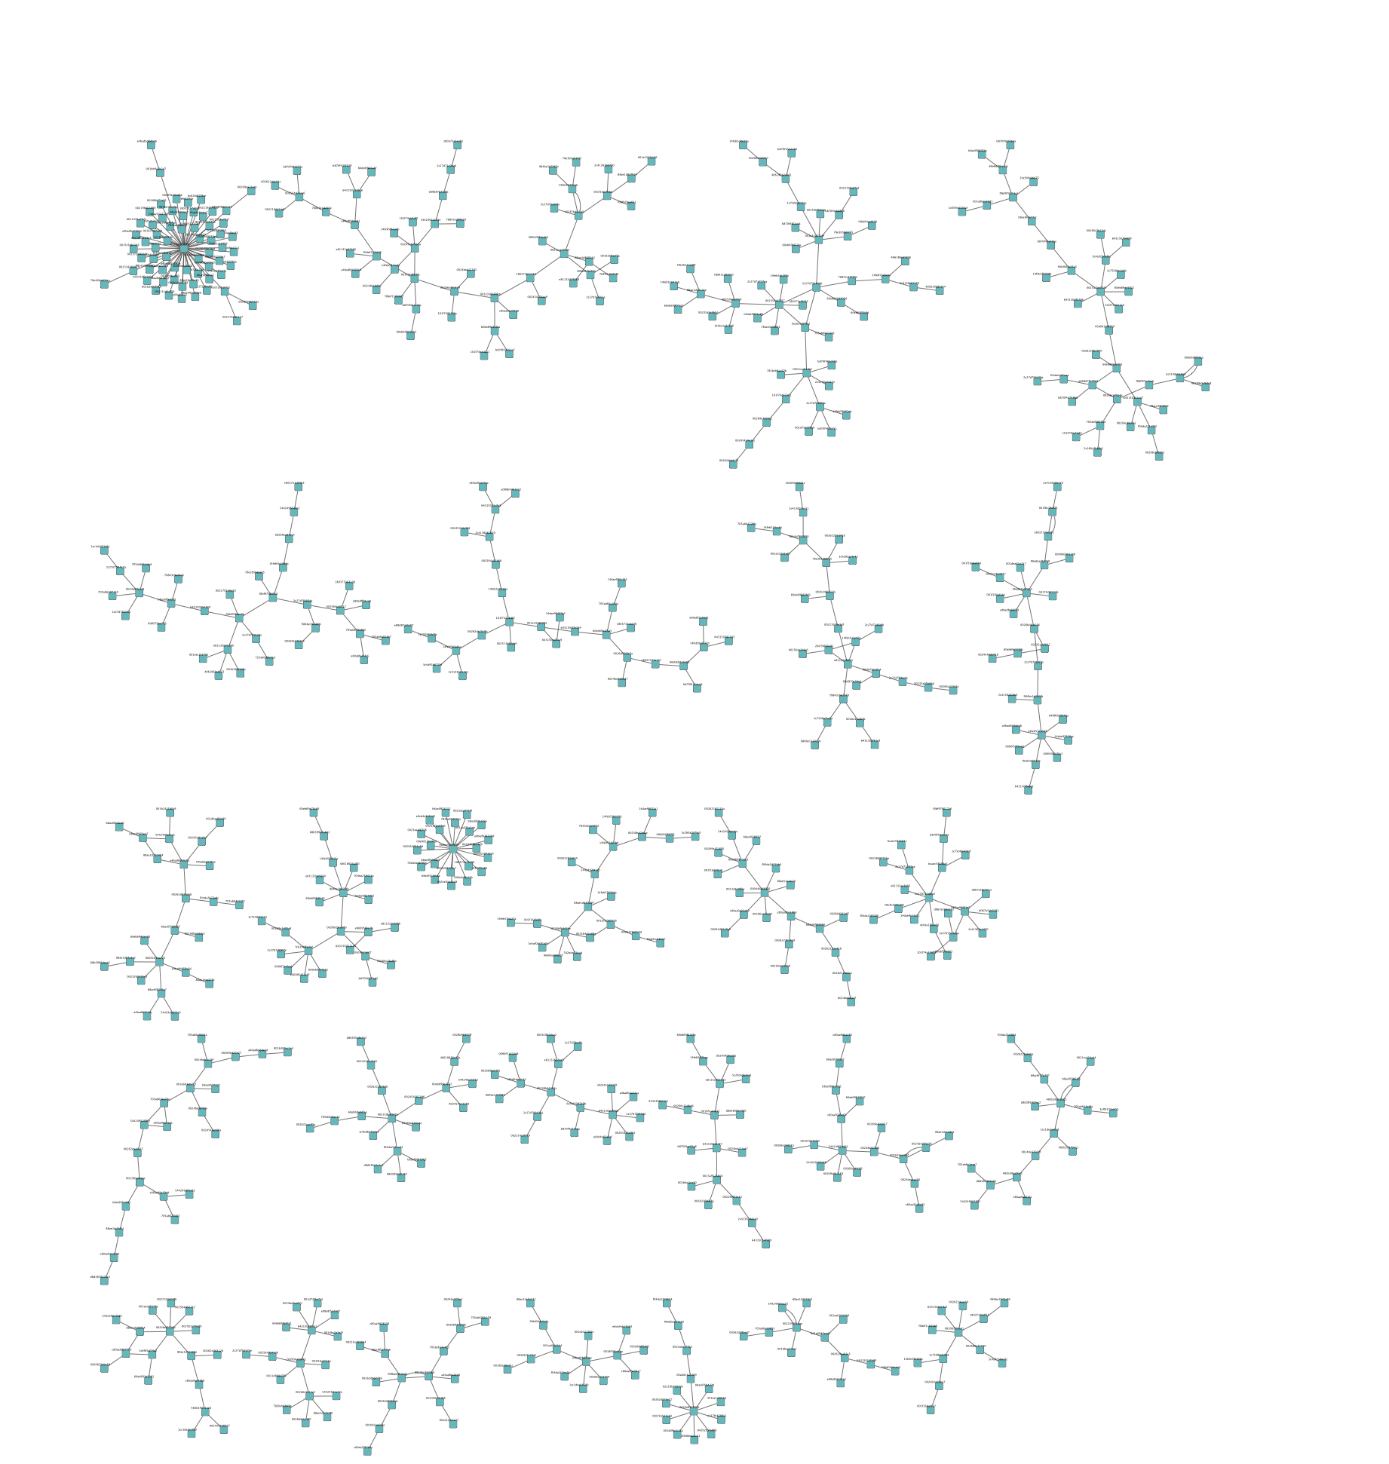
Edges Grouped By Destination MAC For
Port 135: Microsoft Endpoint Mapper
Substantial structure revealed
Star topologies may represent organizational servers or printers
Tree topologies may represent communities that share information between individual peers
Many services use RPC, so this does not indicate what is shared

Slide 180
Microsoft Server Message Block Protocol (SMB) (TCP Port 445)
Primarily used for file and device sharing by Windows machines
Very widely implemented, including on OS X and Linux

Slide 181
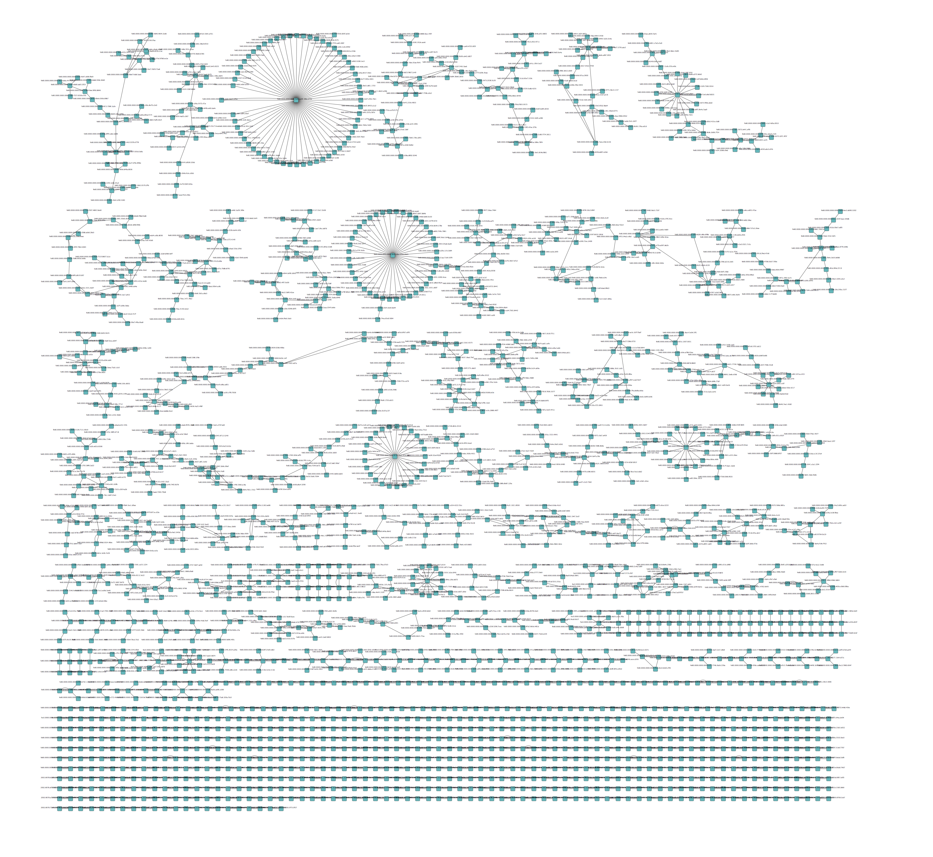
Edges Grouped By Destination MAC For
Port 445: SMB
Substantial structure revealed
Star topologies are most likely file servers or printers
Tree topologies may represent communities that share information between individual peers

Slide 182
Observations So Far…
Organizational social networks may be revealed by graphing network interactions between MAC addresses
IP addresses also work, but are not constant over time
Grouping edges makes data analysis more scalable
Useful interactions do not appear to be present for most IPv6 protocol implementations

Slide 183
Observations So Far…
File sharing protocols provide substantial insights into organizational social networks and interactions
These likely represent social networks for specific organizations or projects
Correlating these graphs with external data such as hostnames may help to reveal the purpose of the interactions, not just the social network structure

Slide 184
Next Steps
Combine data from multiple protocols for interesting graphs
Obtain and run analysis with IPv4 dataset
  Already requested from UC Davis IET
Confirm social networks found with IET
Look at protocols not well represented in IPv6 data set
Examine how the graphs change over time
Cluster analysis

